Slide 1
Objectives (Chiba Campaign 2018)
Better understanding of spatial-temporal variations in trace gases, aerosols, clouds, and radiations around Chiba
trace gases: 4AZ-MAXDOAS
aerosols: POMs, CIMEL, MAX-DOAS, lidar, PM2.5 inst., etc.
clouds: MWR, sky camera
radiations: pyranometers, etc.
※ to be combined with satellite data
(Himawari-8, GCOM-C (Shikisai), OMI, TROPOMI, GOME-2, MODIS, GOSAT, etc.)
※ expected for better interpretation of trend analysis
Multi-pyranometer/multi-sky-camera observations
For better understanding of the 3-D cloud and radiation fields
Intercomparison exercise
aerosols: POMs, CIMEL, MAX-DOAS, lidar, PM2.5 inst., etc.
clouds (COD): MWR, whole-sky cameras, POM, pyranometers, satellites, ...
water vapor (PWC): MWR, POM, CIMEL, MAX-DOAS, ...
Others

Slide 2
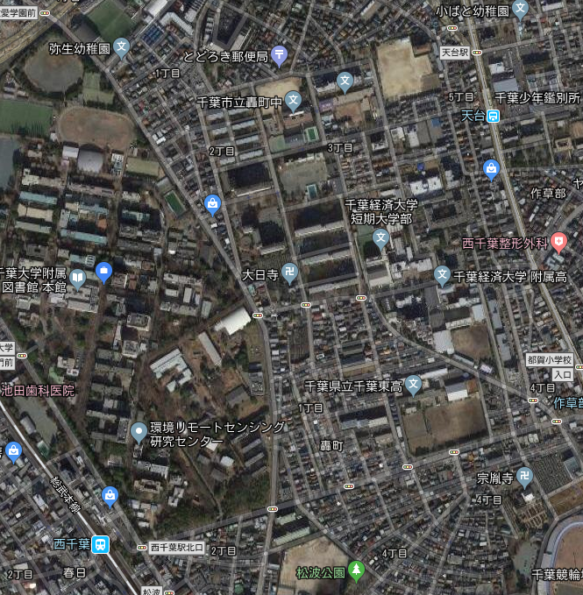
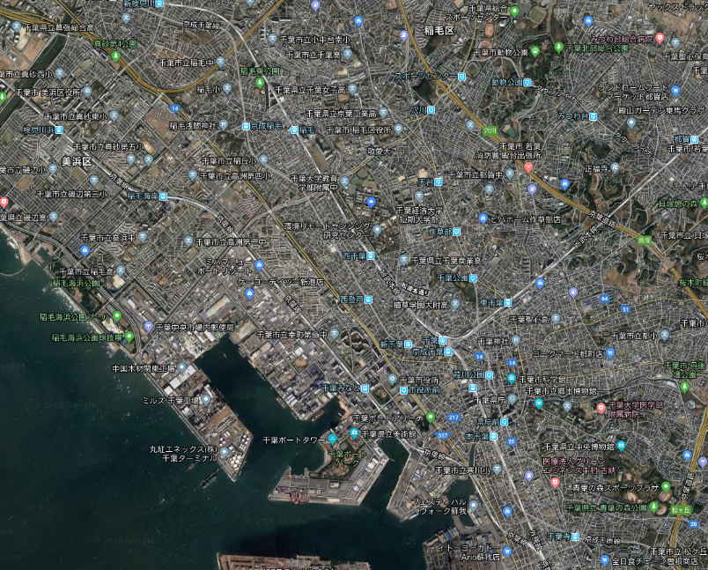
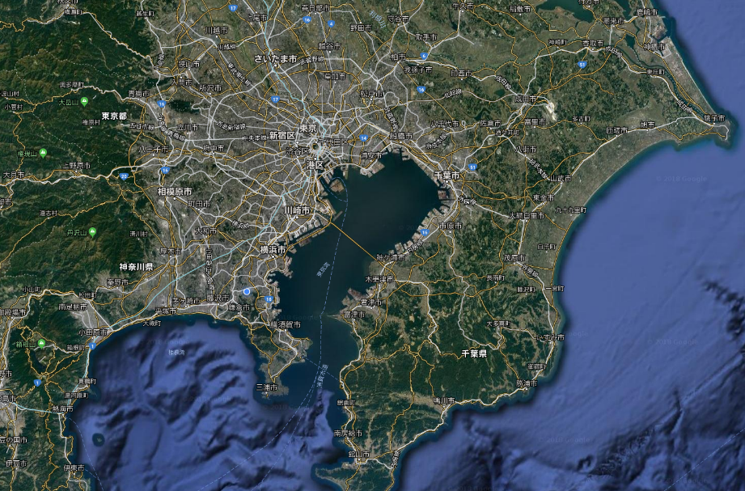
Multi-pyranometer/multi-sky-camera observations
Faculty of Engineering (FE)
CEReS
- 2 sets of instruments for consistency test

Slide 3
Instruments to be used
# | Site | Pyranometer | Whole-sky camera | Met. obs. instrument (p, T, RH) | Remarks
1 | CEReS | CM21 (running) | PSV-100W2(new) (running | SKYNET system (running) | SKYNET site
 |  | CMP21(new)+Okamoto-san’ & Nakanishi-san’s logger (ready) | JAXA camera (ready) Takamura-sensei’s camera (w/o cover) (ready) | Okamoto-san’ & Nakanishi-san’s system (ready) | Focusing on a couple of days
2 | FE | CMP21+Horio-kun’s raspi system (ready for install) | Takamura-sensei’s camera (running) | Takano-sensei’s system (running) | Takano-sensei’s place

