Slide 1
Chiba Campaign 2017
MAX-DOAS 3D plots (7/14)

Slide 2
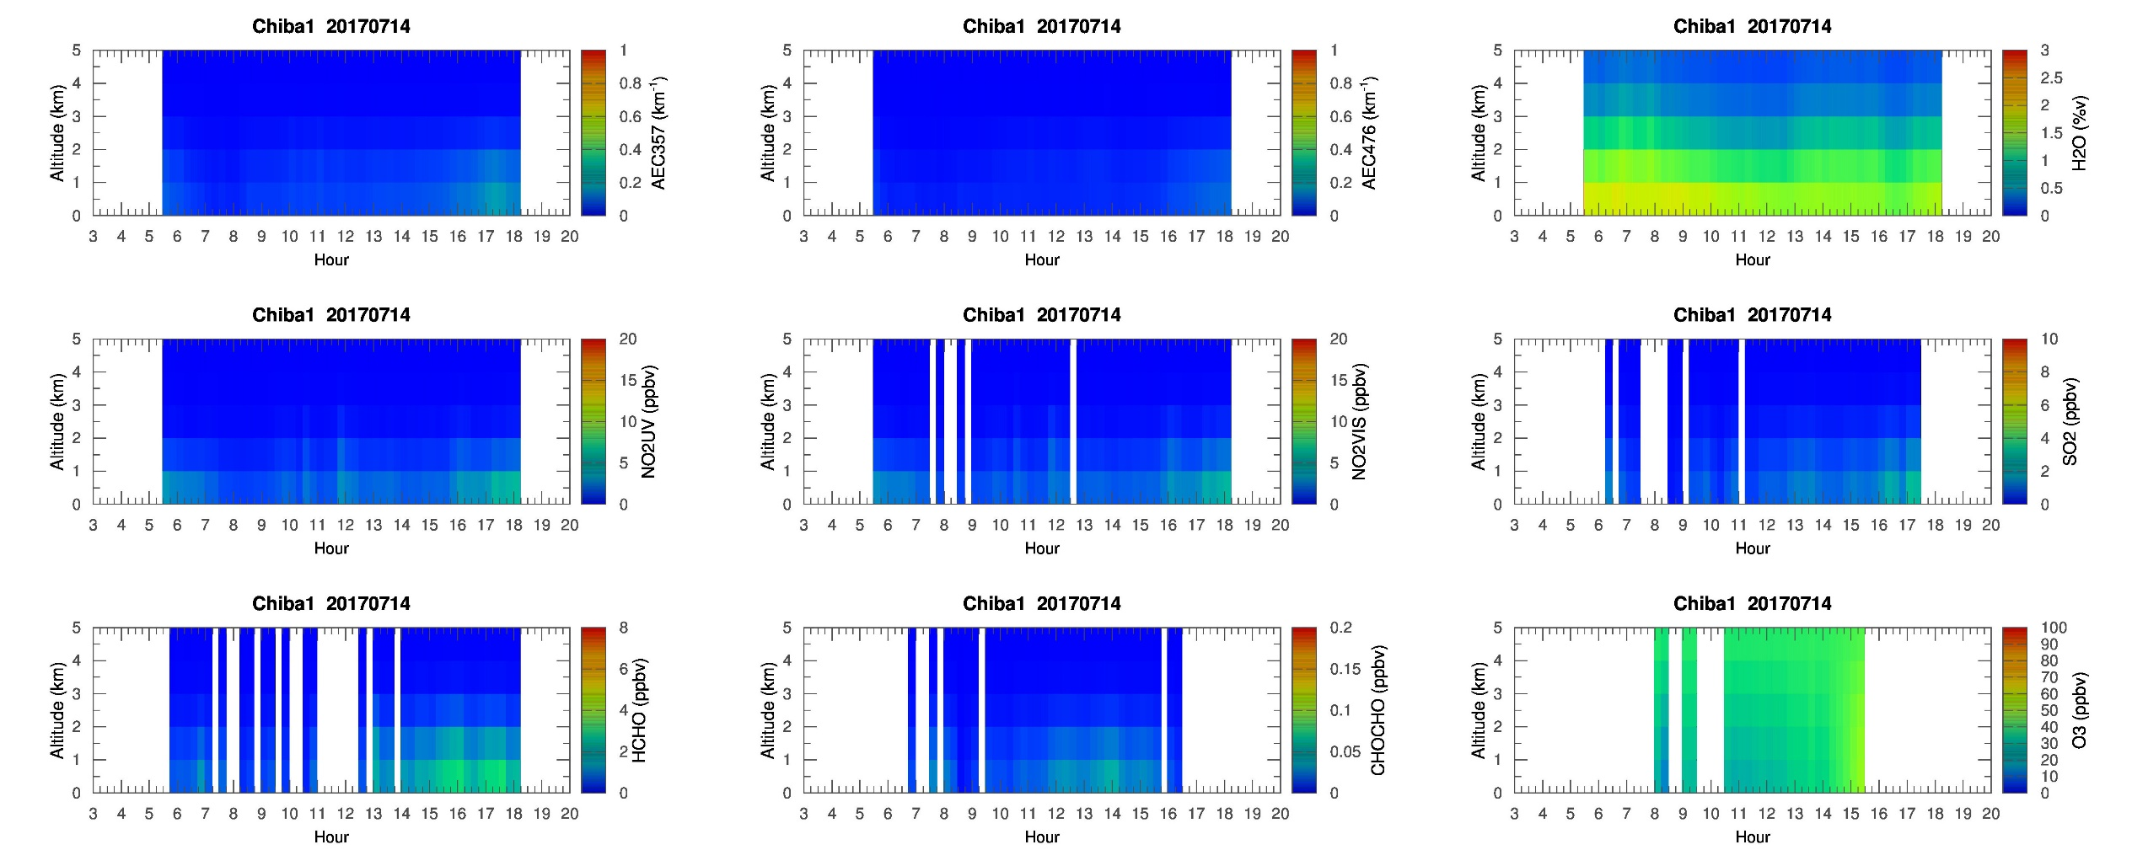
MAX-DOAS 1 (North)

Slide 3
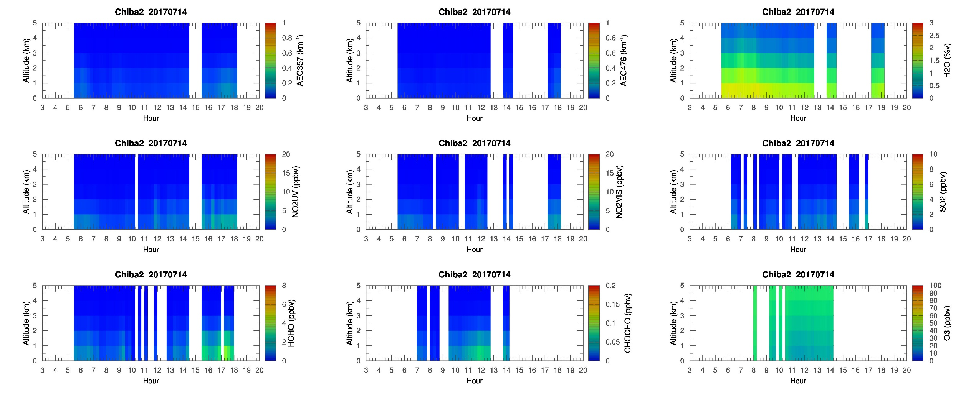
MAX-DOAS 2 (West)

Slide 4
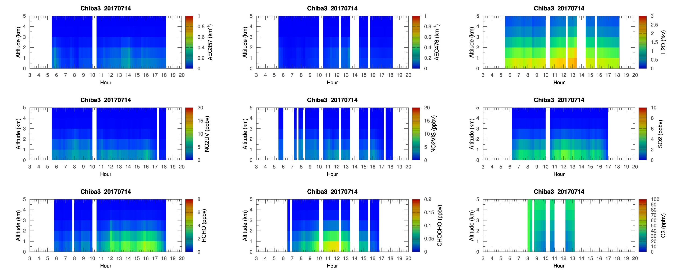
MAX-DOAS 3 (East)

Slide 5
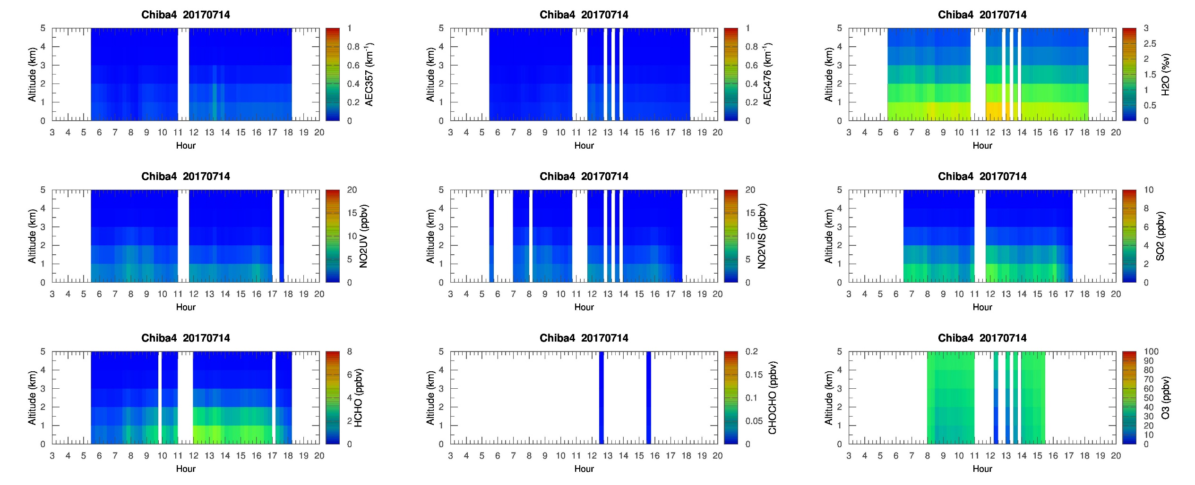
MAX-DOAS 4 (South)

Slide 6
Chiba Campaign 2017
MAX-DOAS 3D plots (7/15)

Slide 7
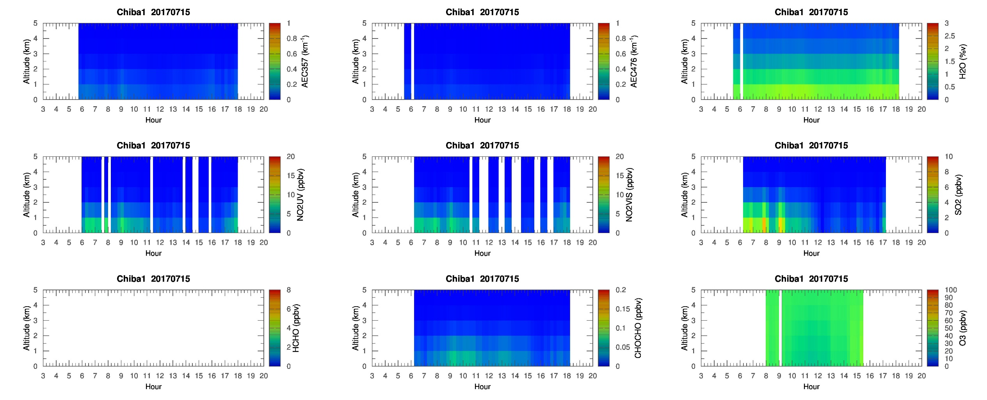
MAX-DOAS 1 (North)

Slide 8
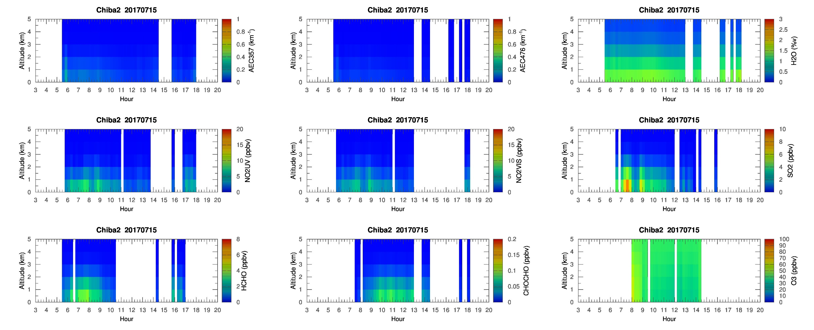
MAX-DOAS 2 (West)

Slide 9
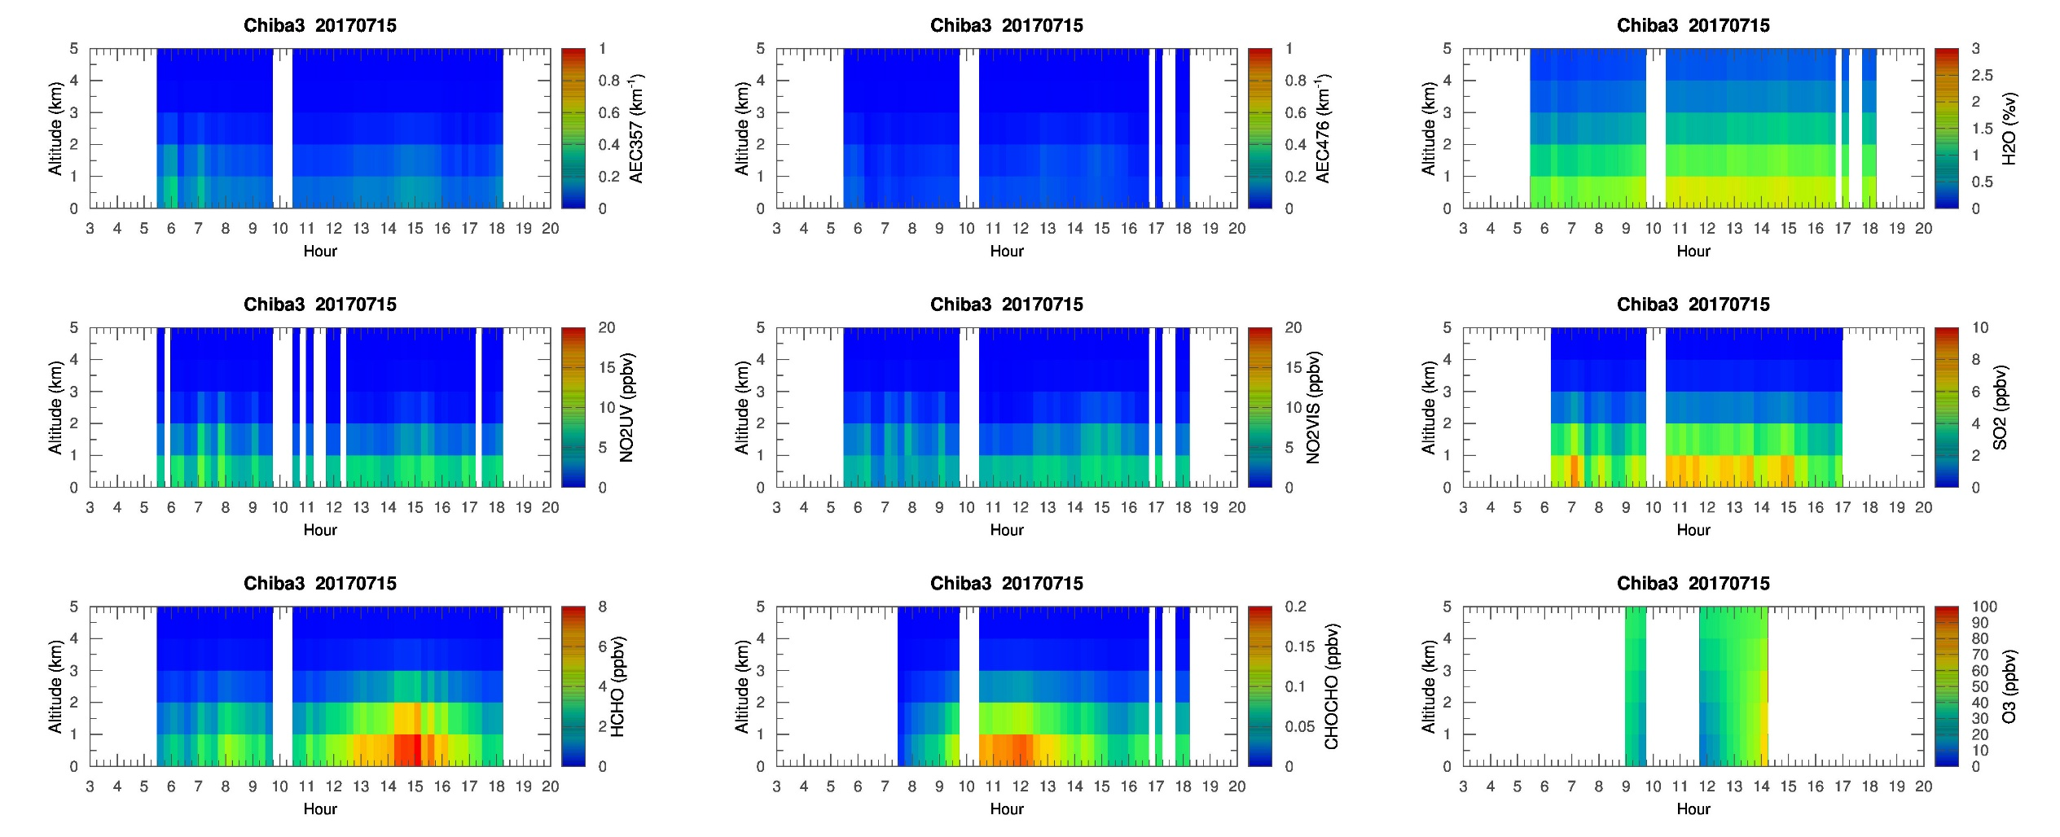
MAX-DOAS 3 (East)

Slide 10
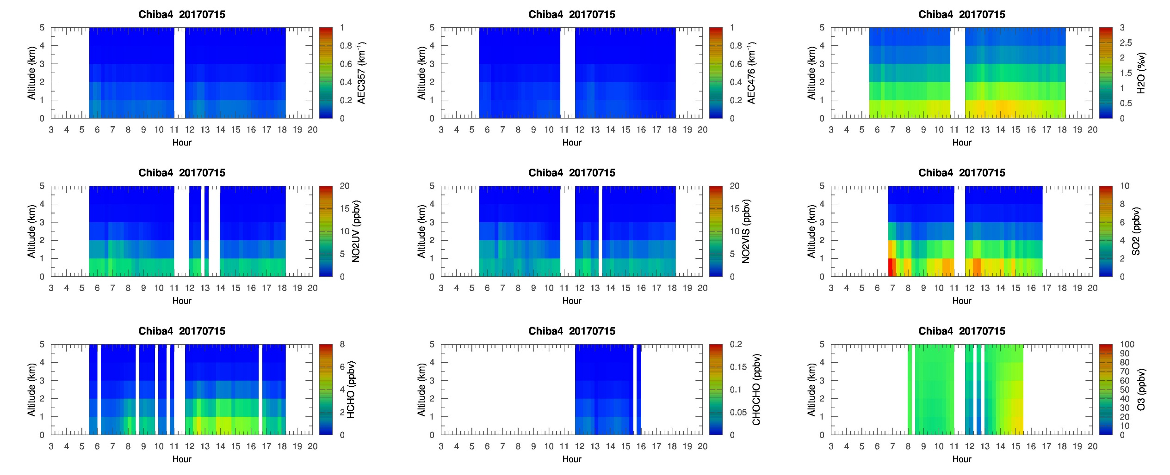
MAX-DOAS 4 (South)

Slide 11
Chiba Campaign 2017
MAX-DOAS 3D plots (7/16)

Slide 12
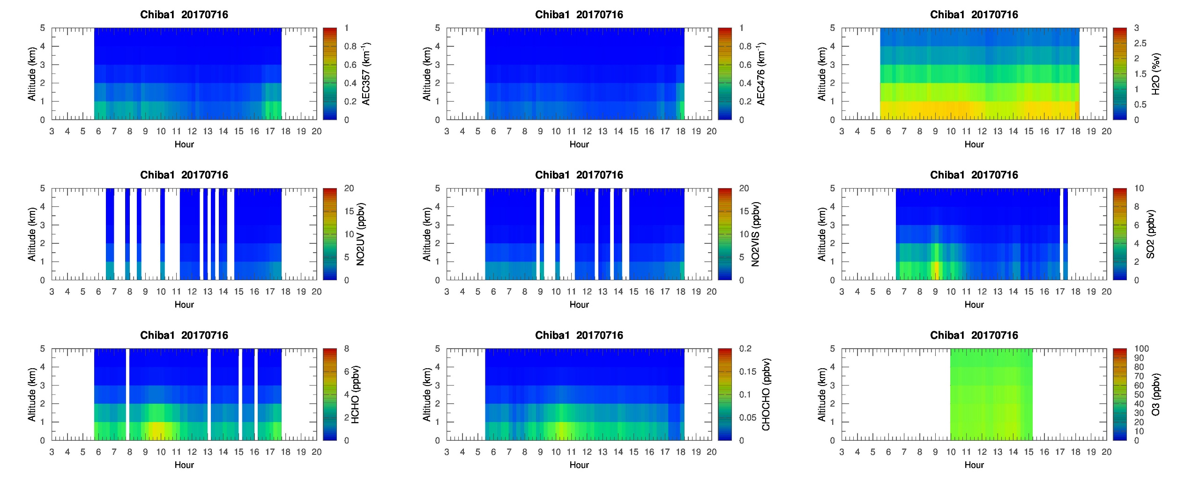
MAX-DOAS 1 (North)

Slide 13
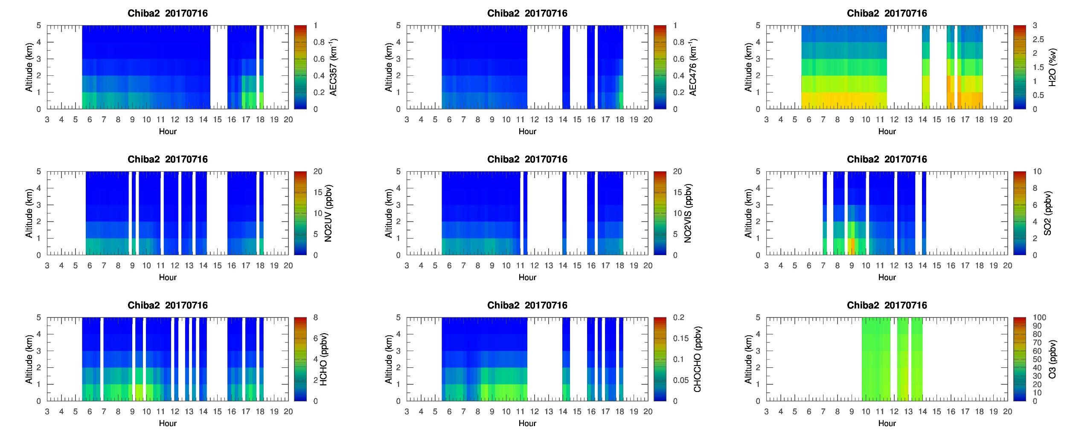
MAX-DOAS 2 (West)

Slide 14
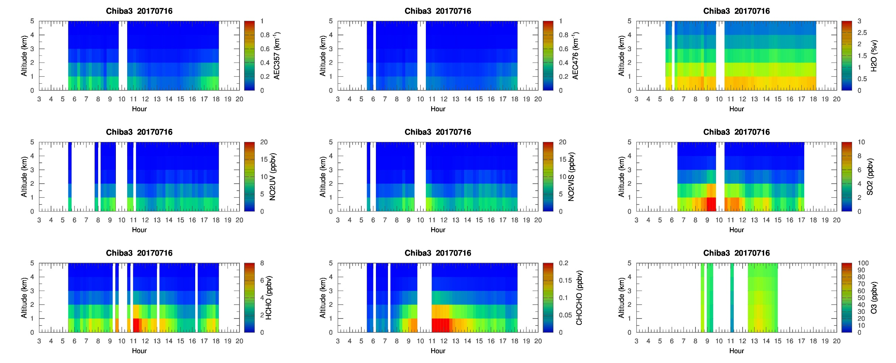
MAX-DOAS 3 (East)

Slide 15
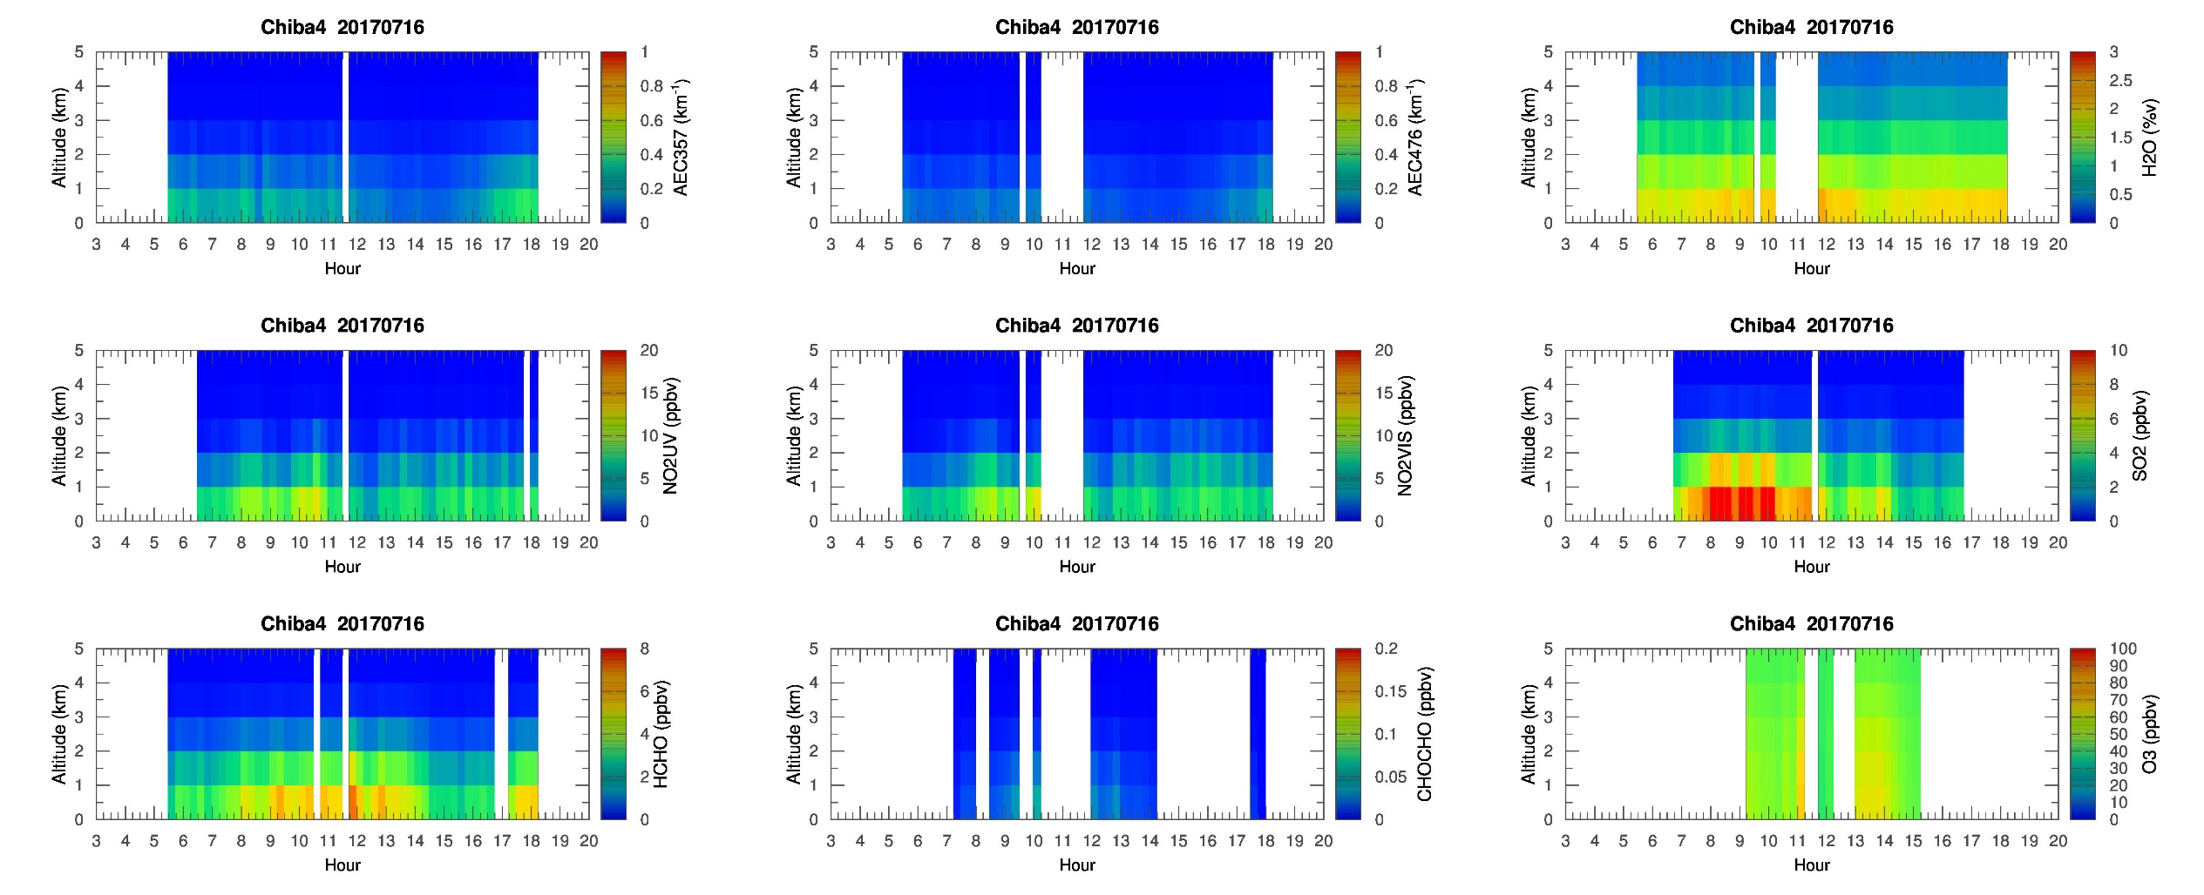
MAX-DOAS 4 (South)

Slide 16
Chiba Campaign 2017
MAX-DOAS 3D plots (7/17)

Slide 17
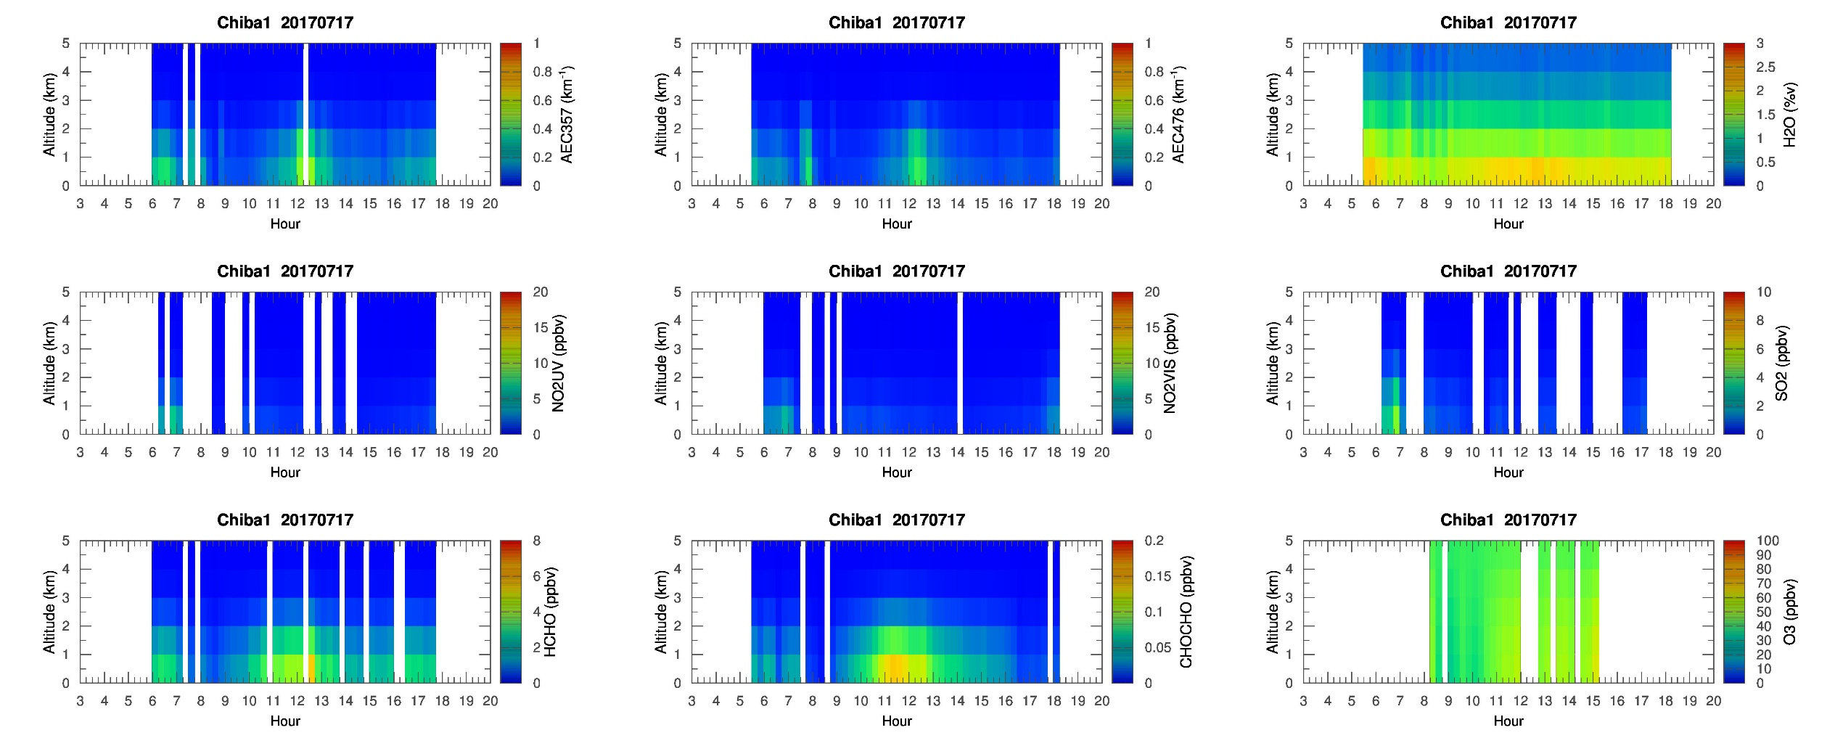
MAX-DOAS 1 (North)

Slide 18
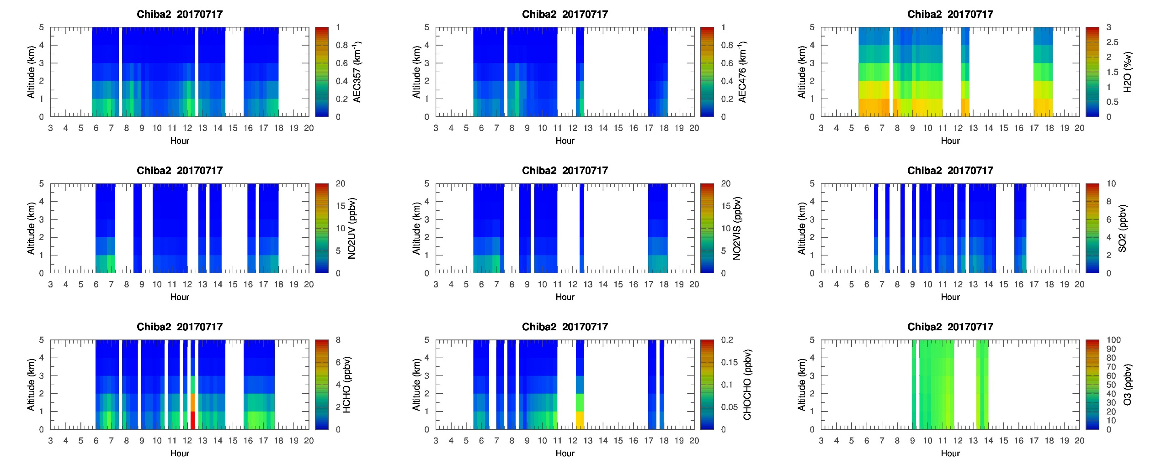
MAX-DOAS 2 (West)

Slide 19
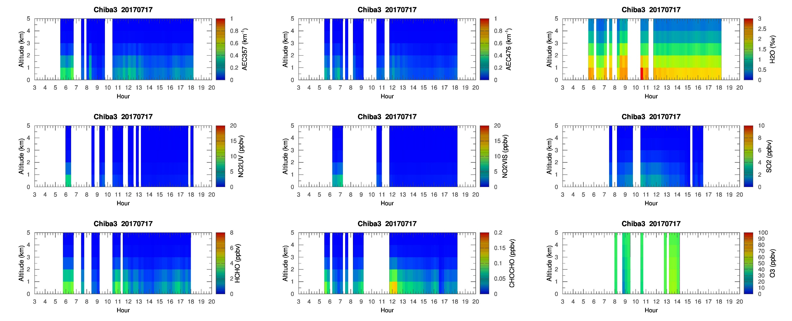
MAX-DOAS 3 (East)

Slide 20
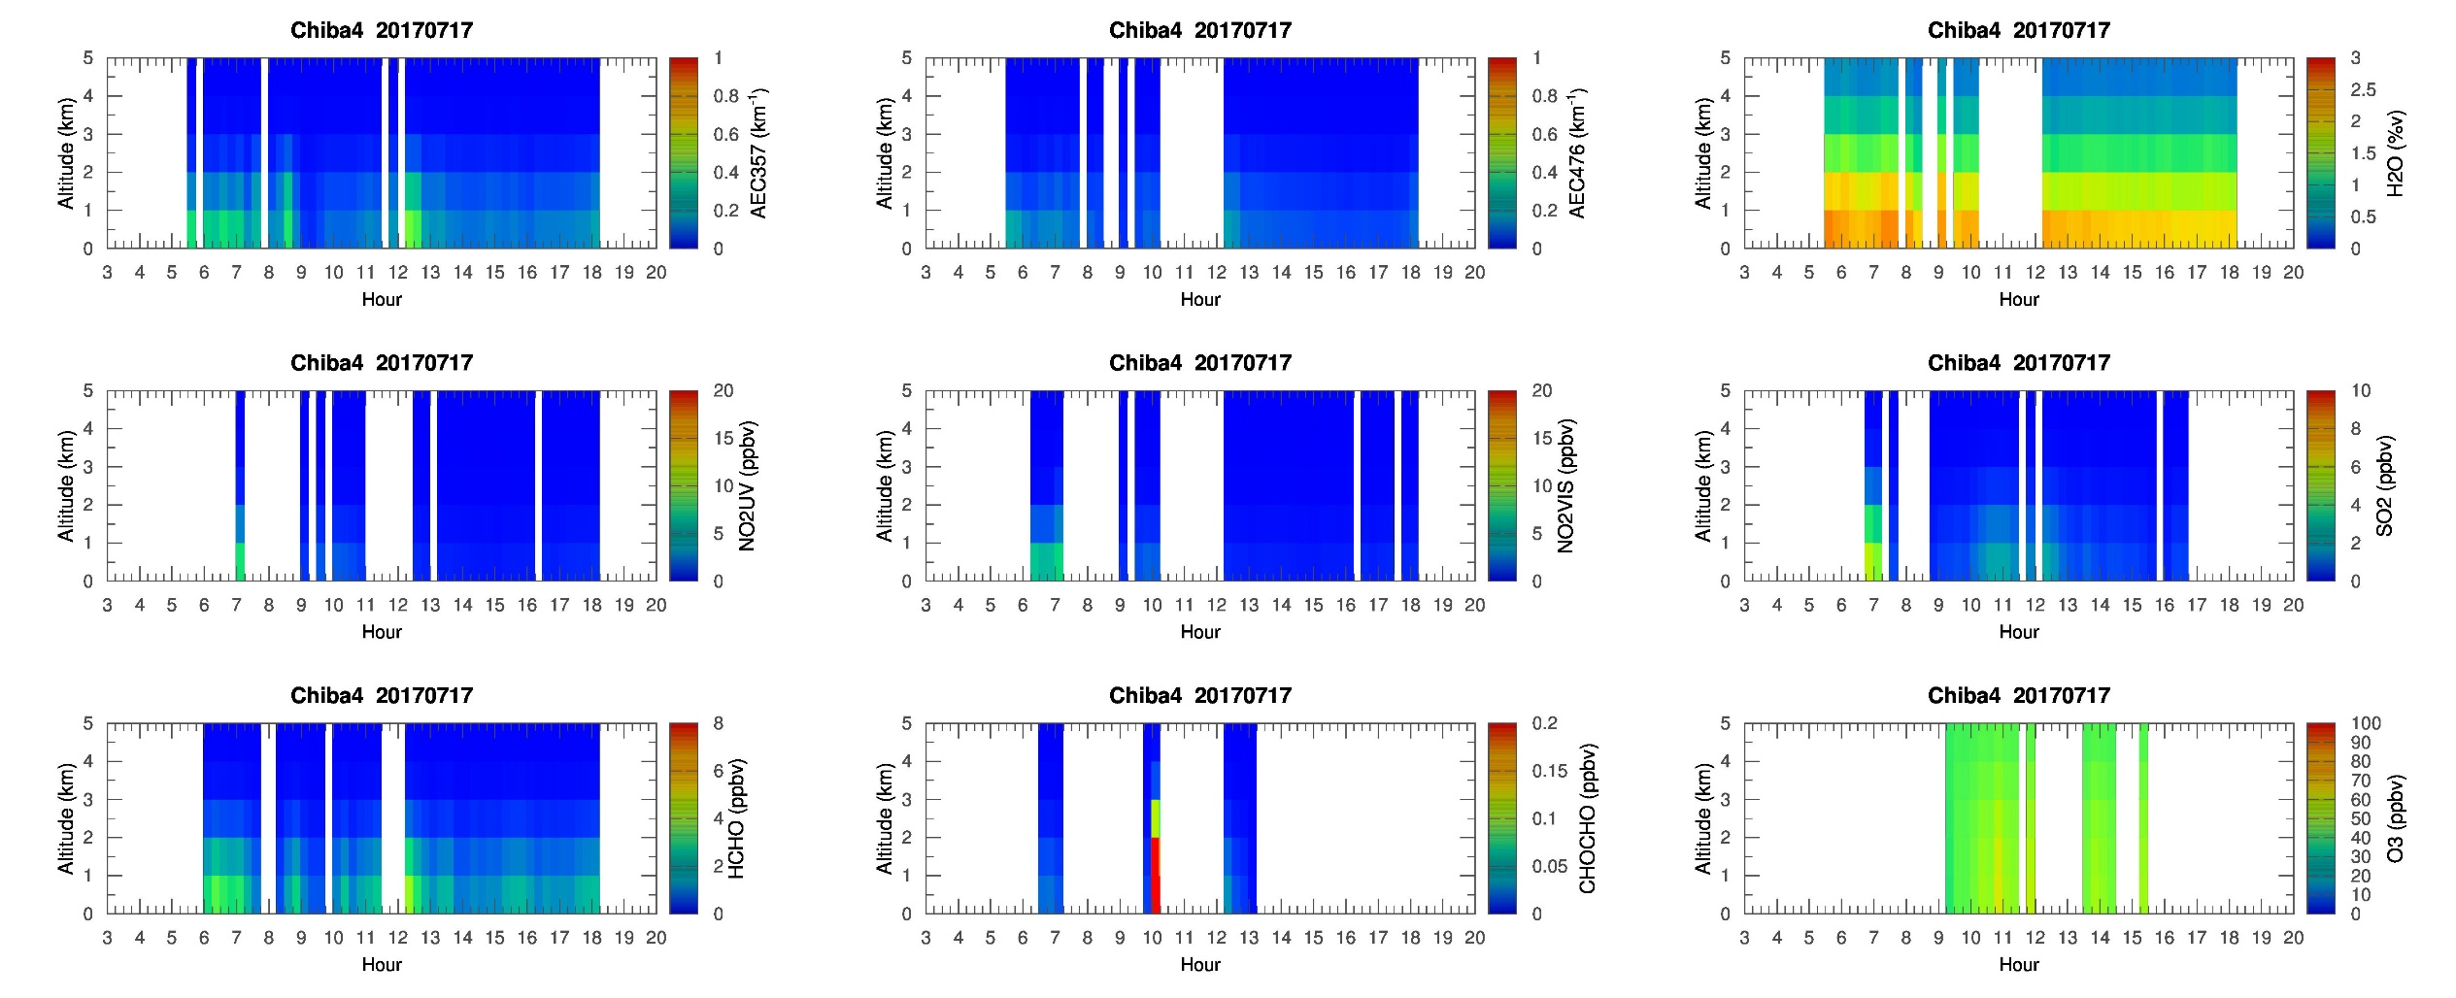
MAX-DOAS 4 (South)

Slide 21
Chiba Campaign 2017
MAX-DOAS 3D plots (7/18)

Slide 22
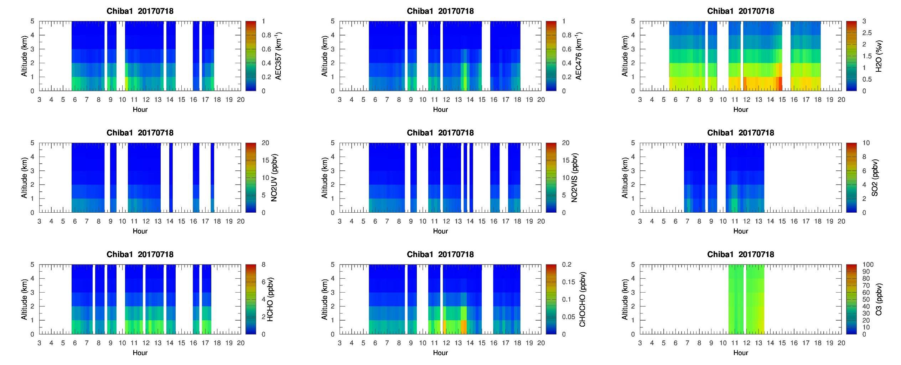
MAX-DOAS 1 (North)

Slide 23
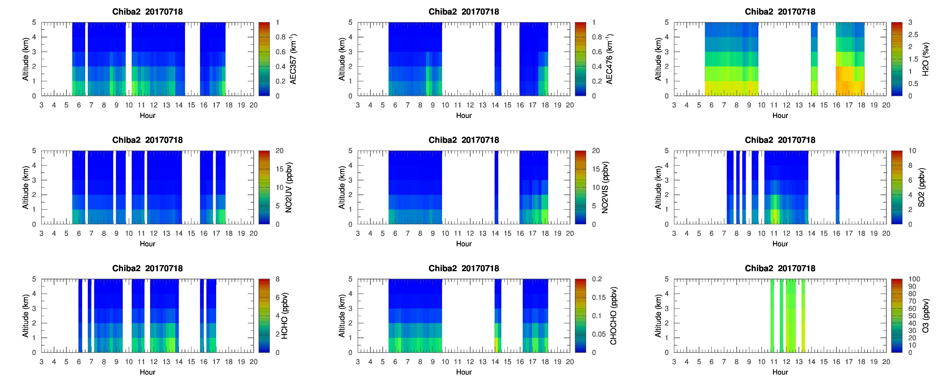
MAX-DOAS 2 (West)

Slide 24
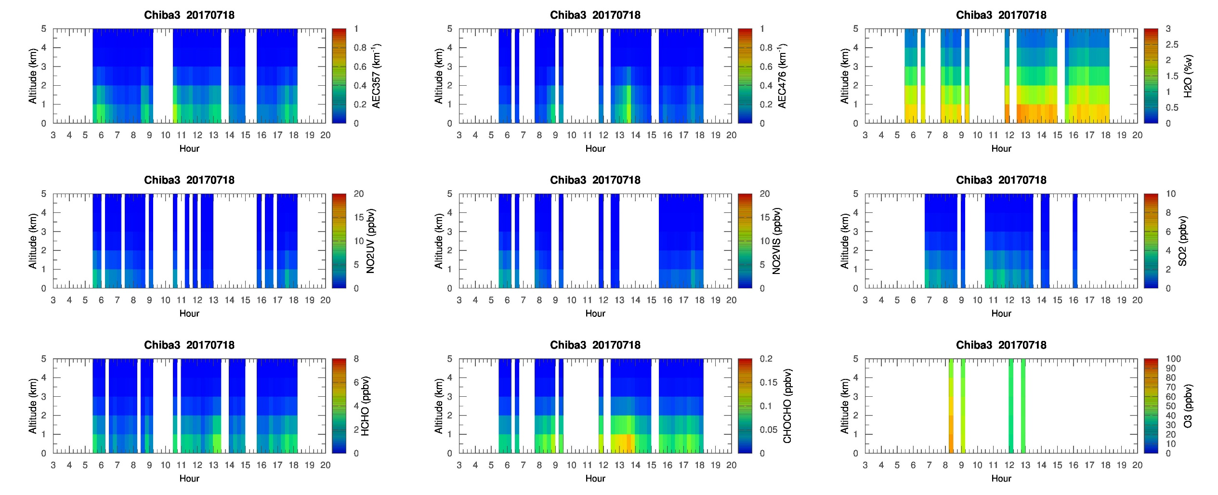
MAX-DOAS 3 (East)

Slide 25
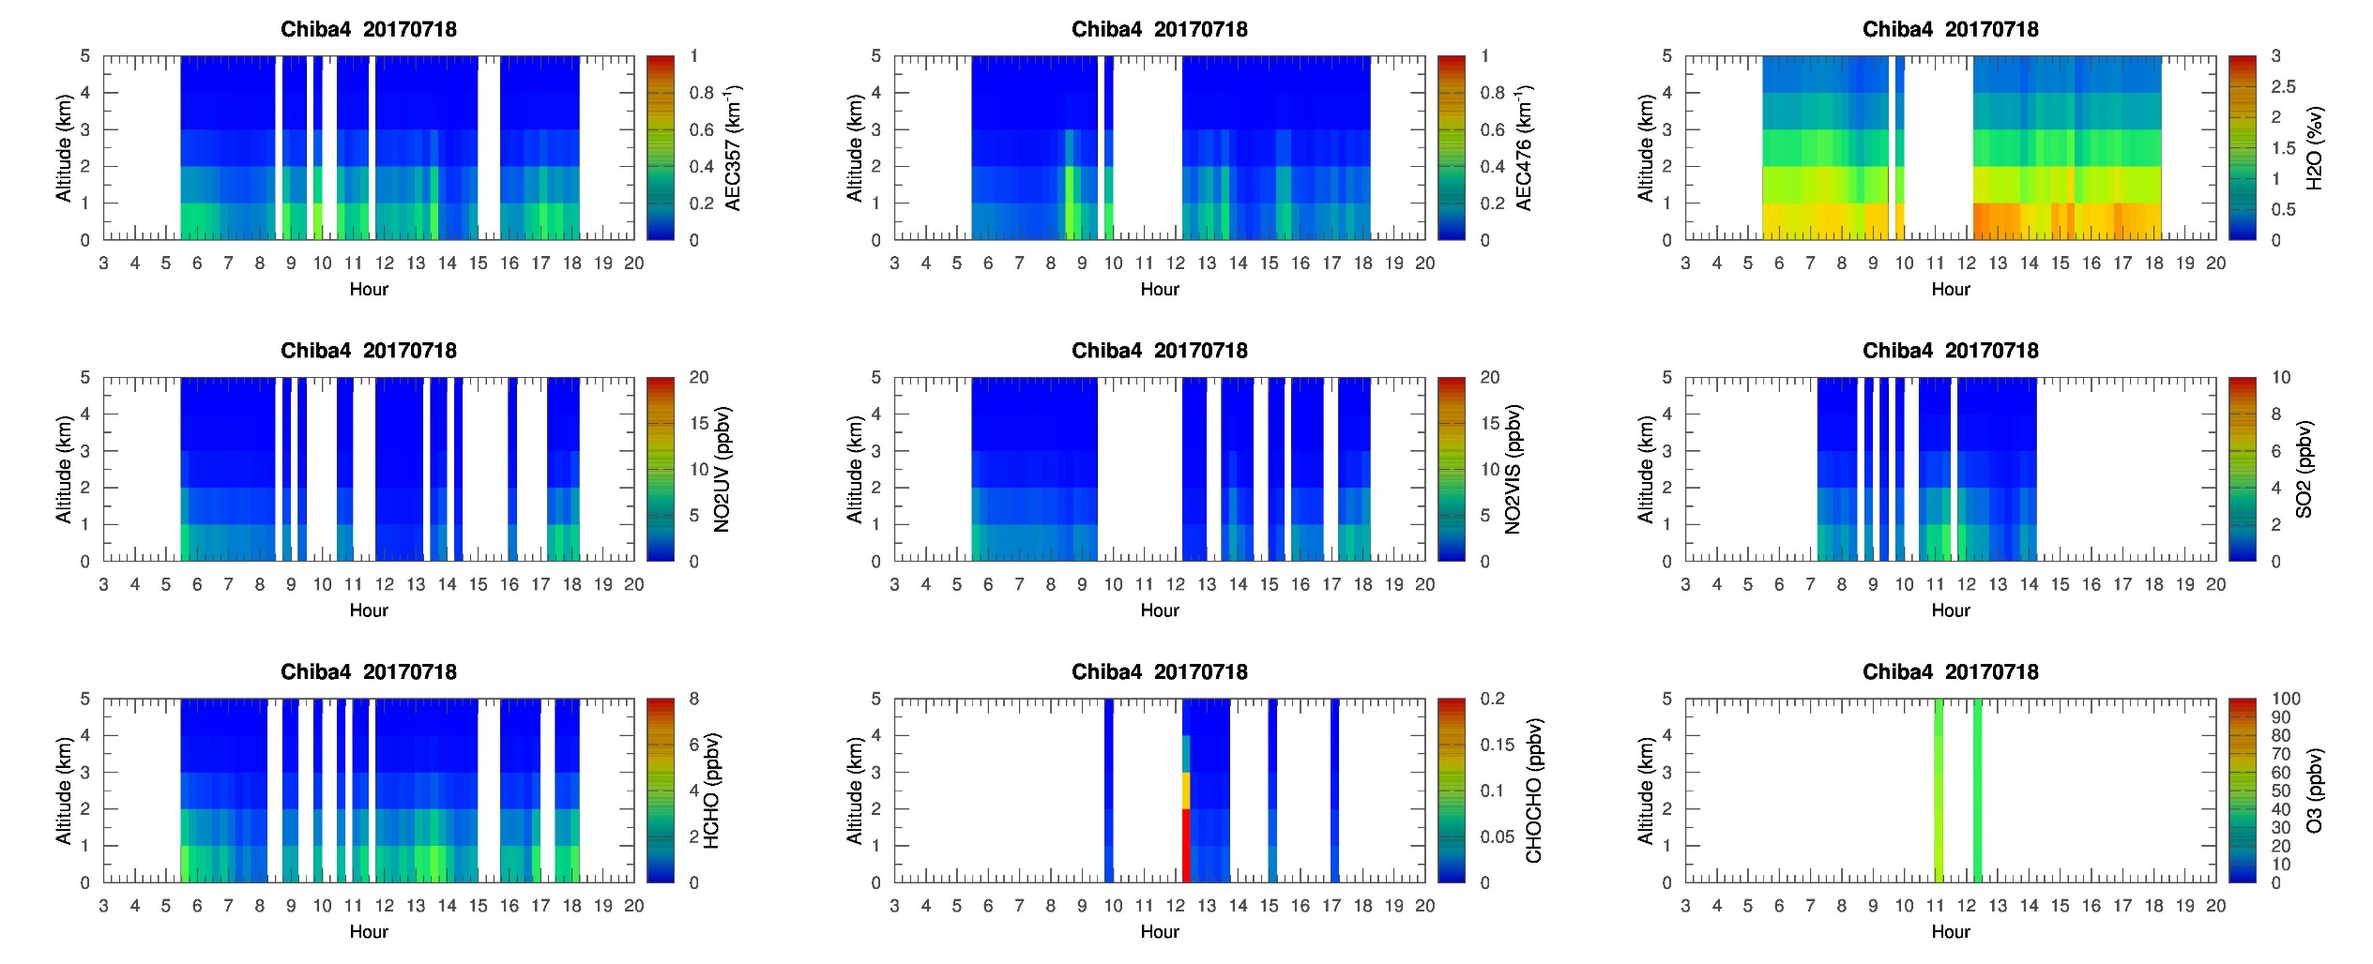
MAX-DOAS 4 (South)

Slide 26
Chiba Campaign 2017
MAX-DOAS 3D plots (7/19)

Slide 27
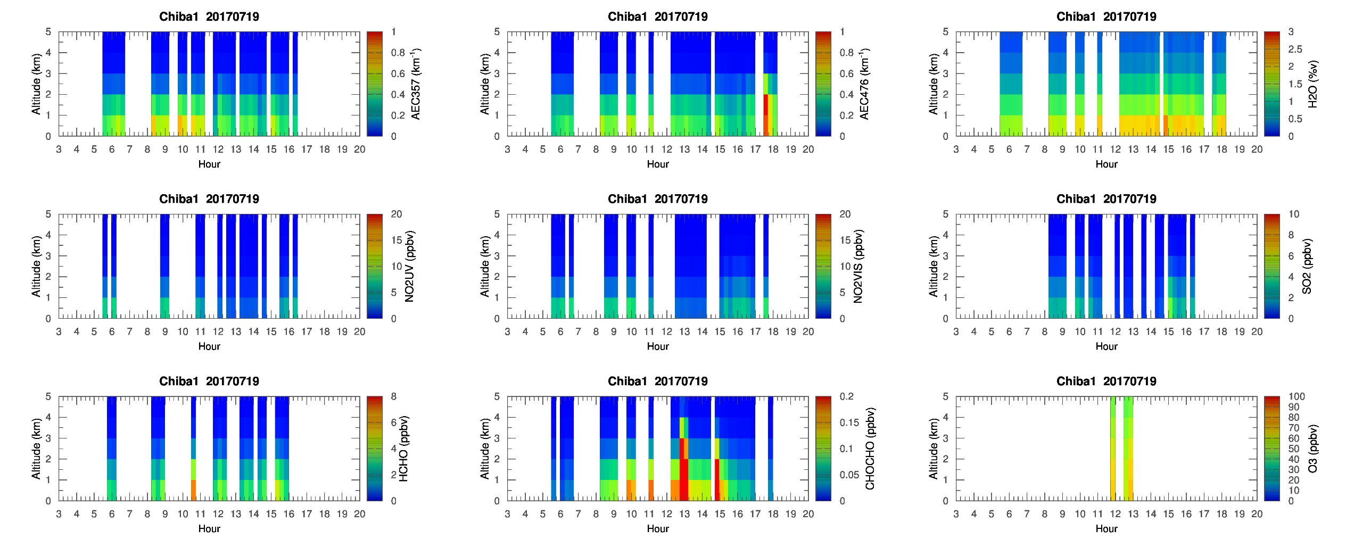
MAX-DOAS 1 (North)

Slide 28
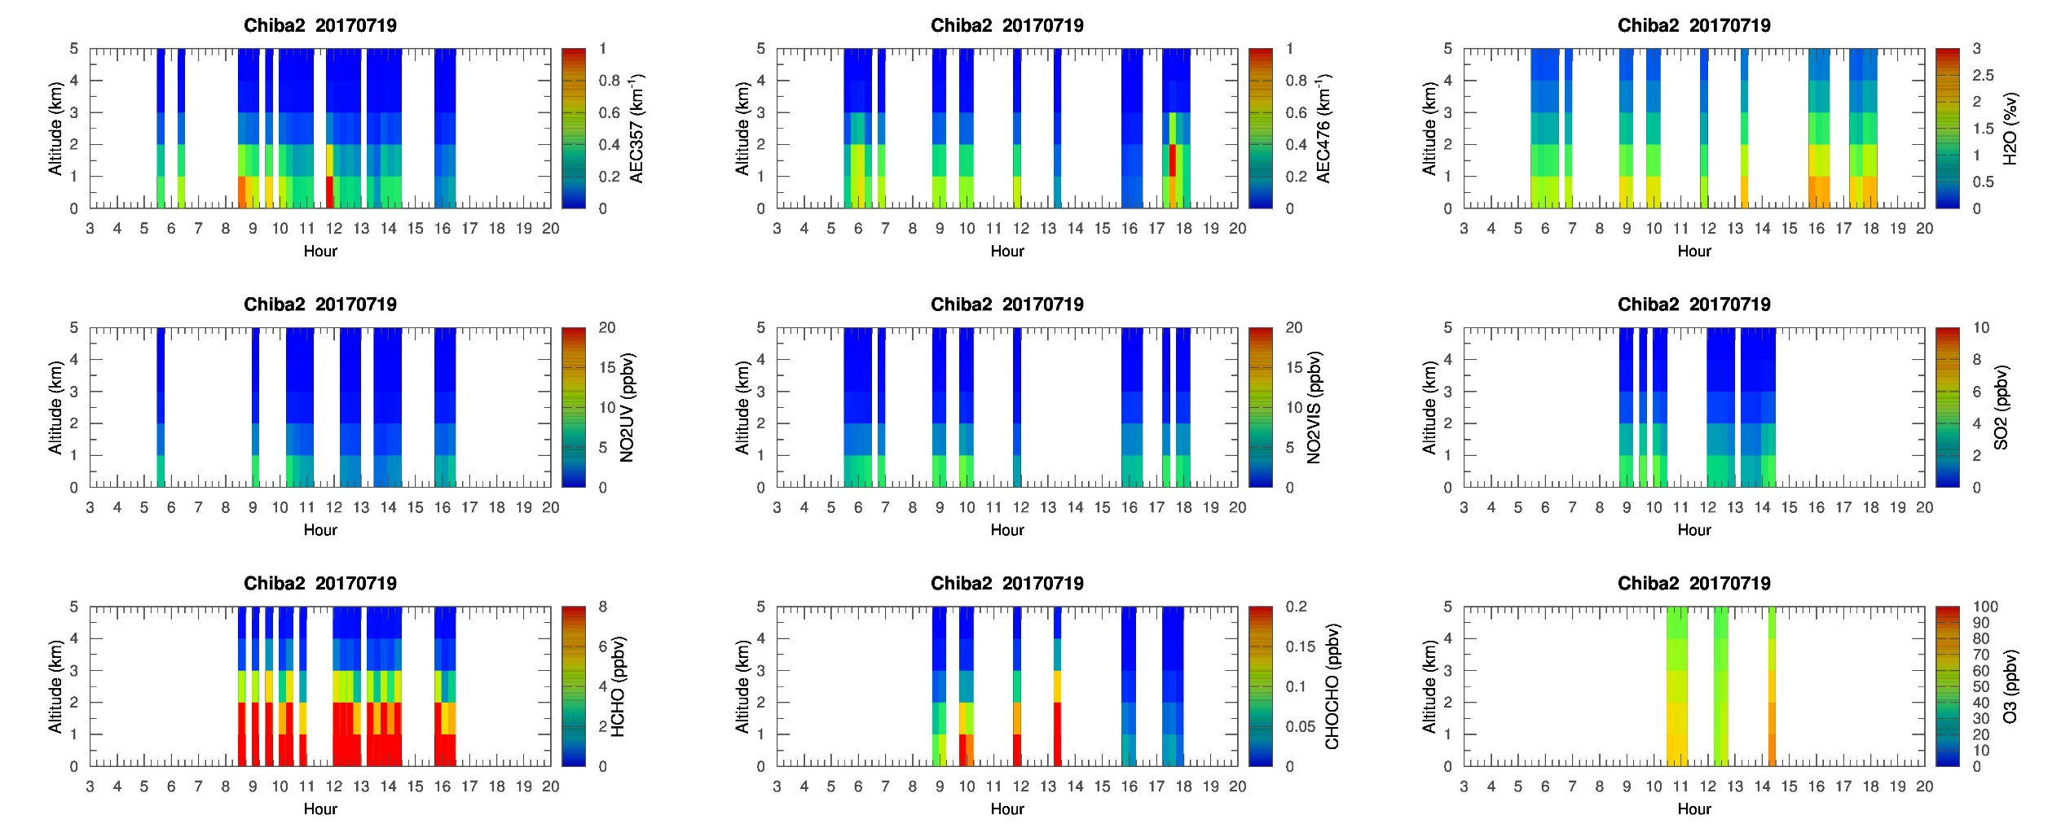
MAX-DOAS 2 (West)

Slide 29
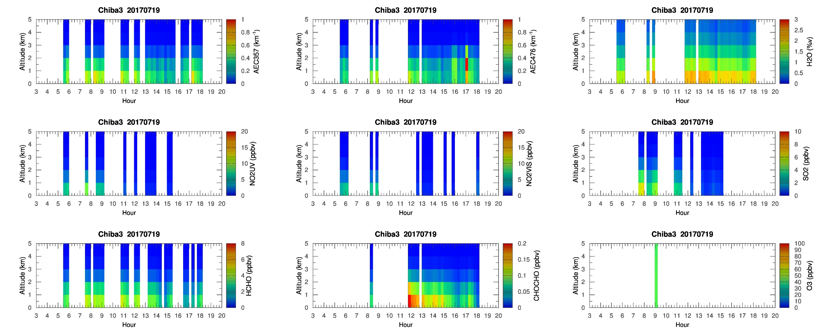
MAX-DOAS 3 (East)

Slide 30
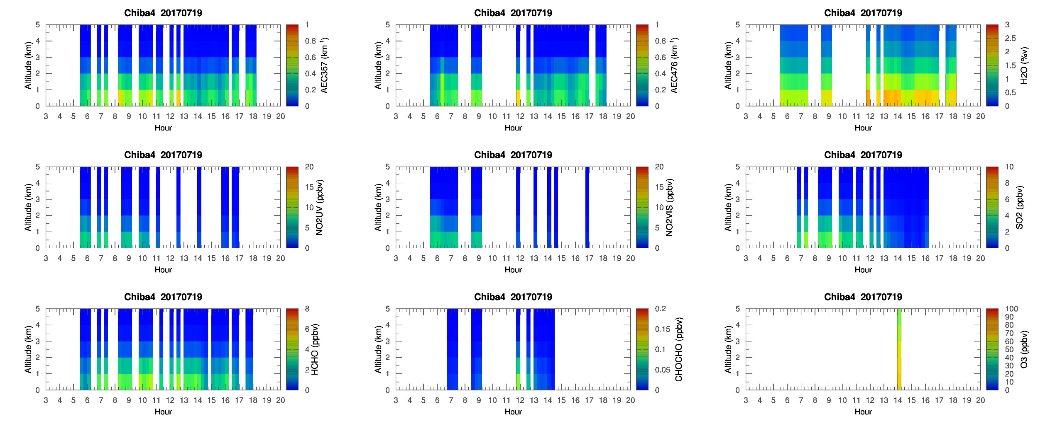
MAX-DOAS 4 (South)

