Slide 1
MAX-DOAS 2d plots for Chiba Campaign 2017 Observation day 12: 07/22/2017 Hoque

Slide 2
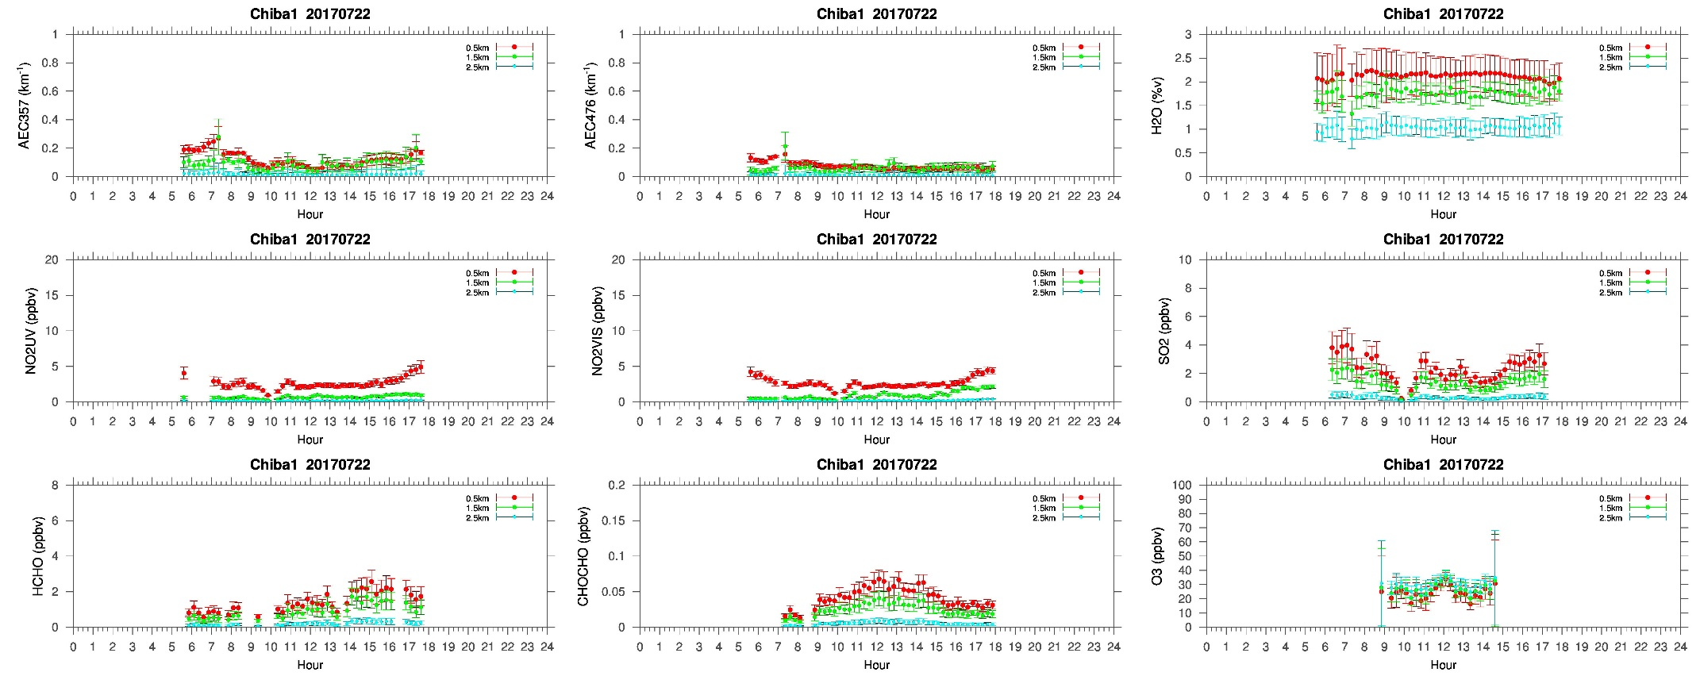
MAX-DOAS#1, North Direction

Slide 3
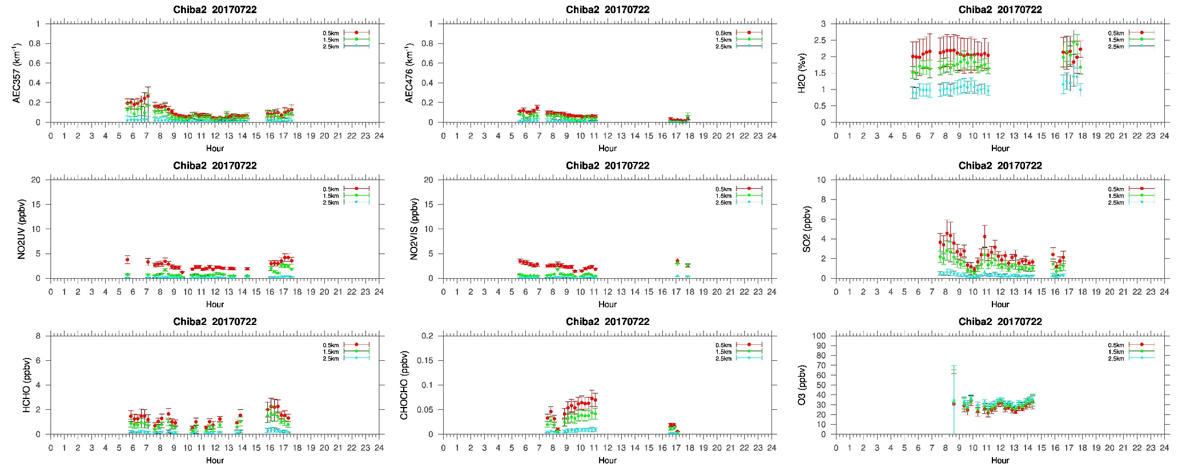
MAX-DOAS#2, West Direction

Slide 4
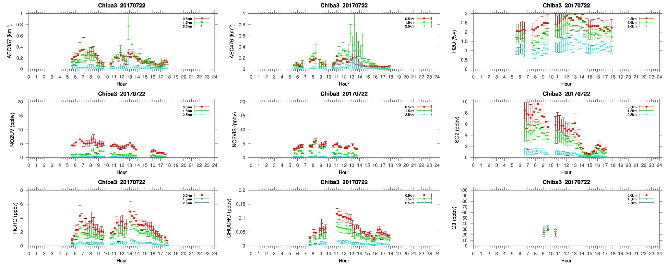
MAX-DOAS#3, East Direction

Slide 5
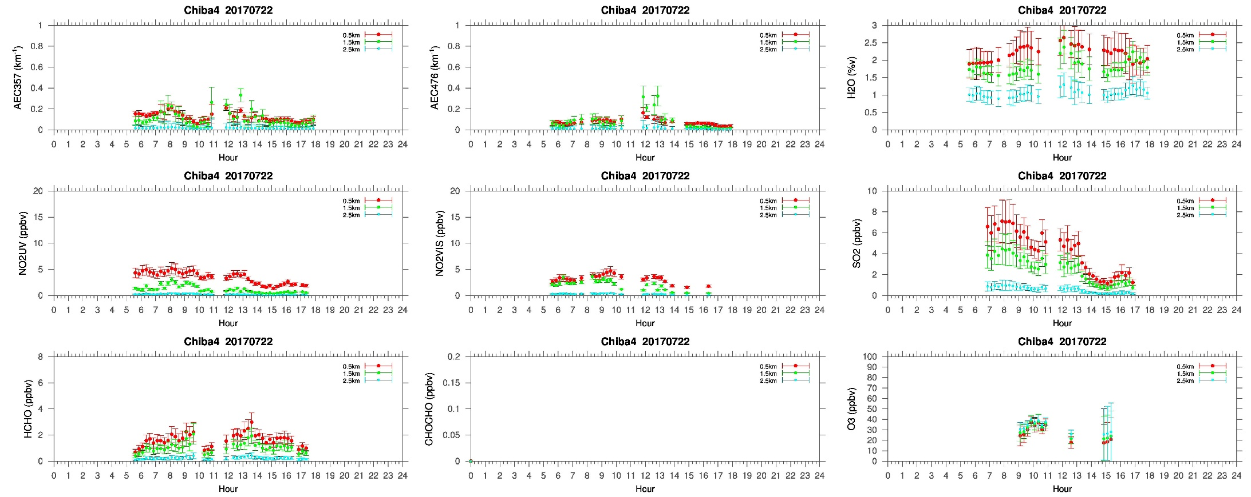
MAX-DOAS#4, South Direction

Slide 6
Comments after a quick look of the plots
Overall a clear day . Although clouds were seen , according to the LIDAR images most of the time it was above 6km. In the first half of the day few clouds were seen below 2km. The AEC distribution for 0-1 km shows a homogenous pattern in all the four directions. Only the AEC for 1-2 km shows a bit different pattern in the east direction (#3),which might be probably due to the lower clouds(<2km) seen during the day. NO2 concentration were below 5ppbv . The SO2 concentration in the east and south were more than 6 ppbv. The concentration in the respective directions were high (>6ppbv) in the morning and the level dropped to ~2ppbv in the late evening, similar concentration level seen in the north (#1) and west (#2) direction. The morning time SO2 concentration in the north (#1) and west (#2) direction were less than 4ppbv. The reasons are not very clear from the initial quick look. But it could be related to the long range transport impact that we have observed on the previous day i.e. 07/21/2017.

