Slide 1
MAX-DOAS 2d plots for Chiba Campaign 2017 Observation day 8: 07/18/2017 Hoque

Slide 2
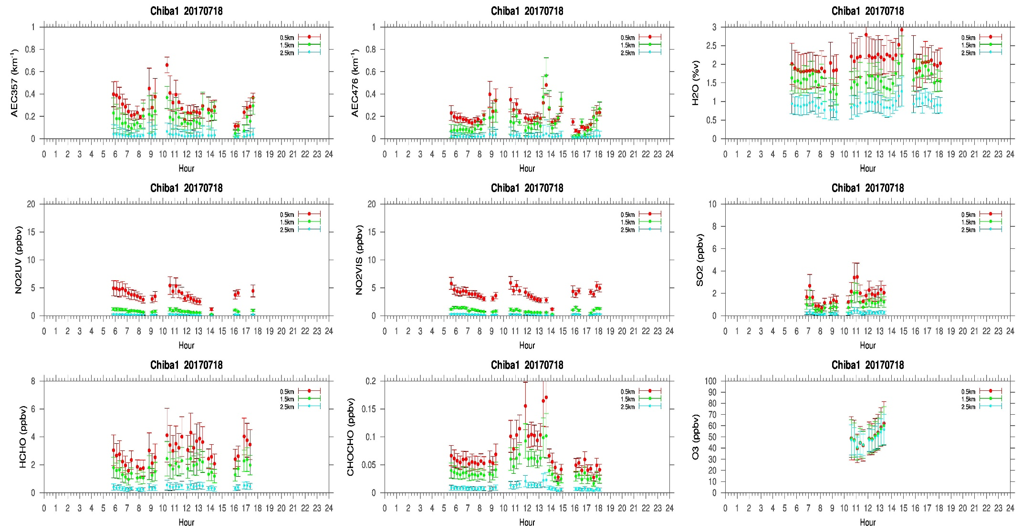
MAX-DOAS#1, North Direction

Slide 3
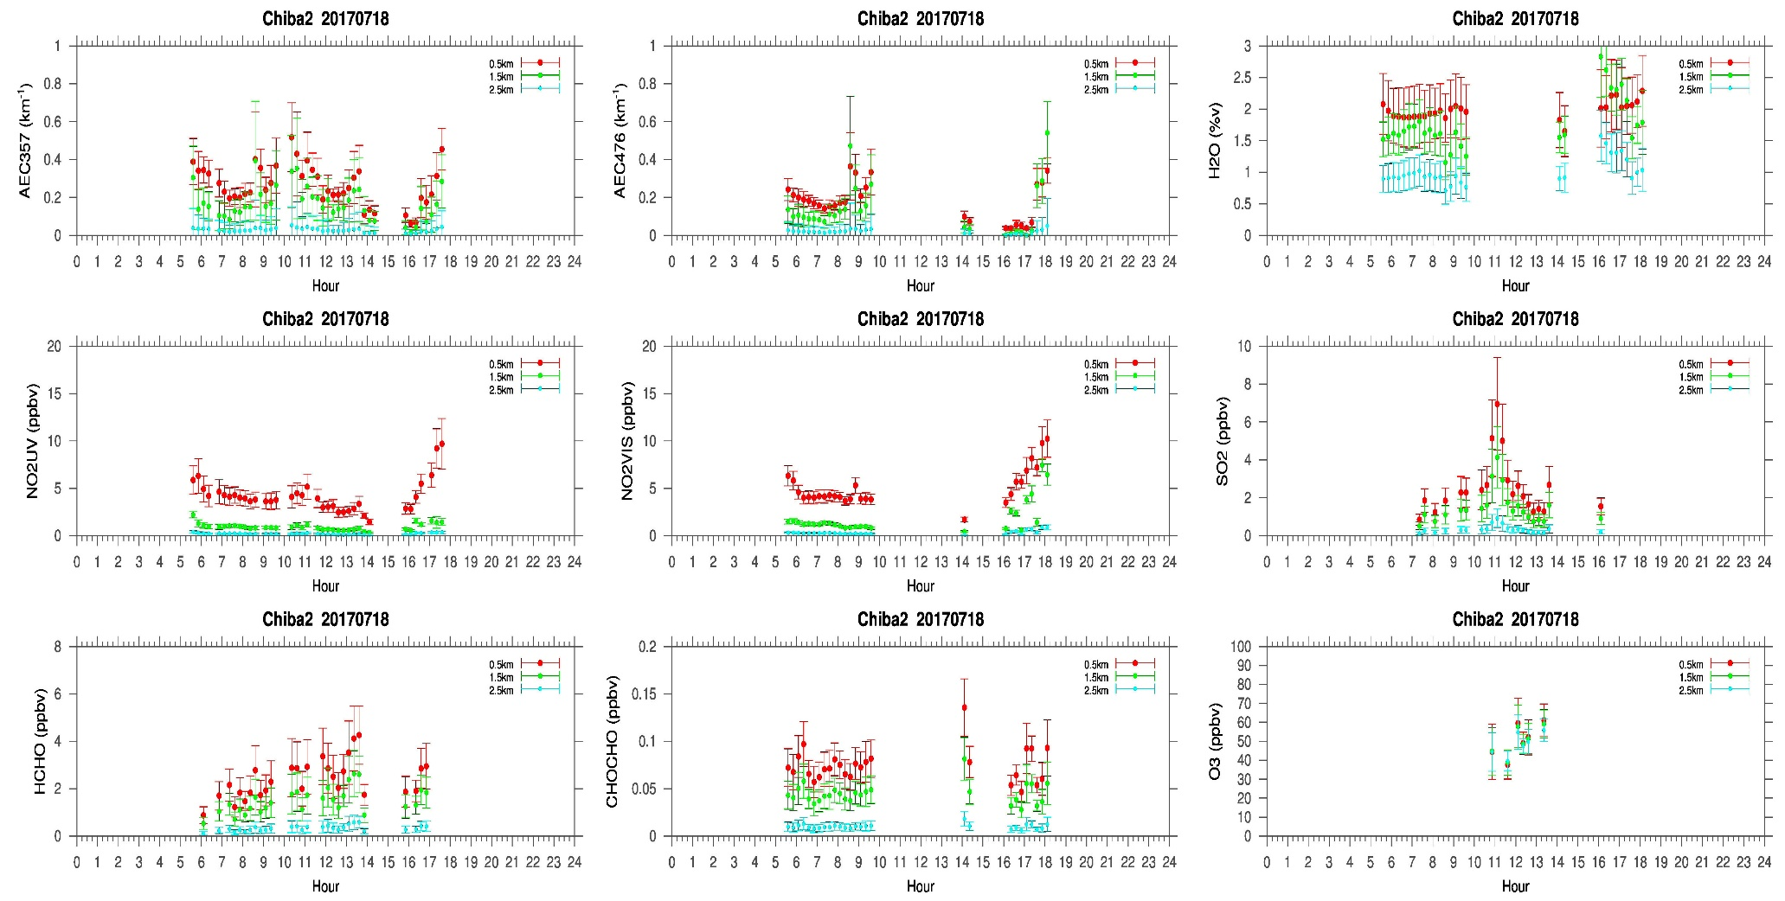
MAX-DOAS#2, West Direction

Slide 4
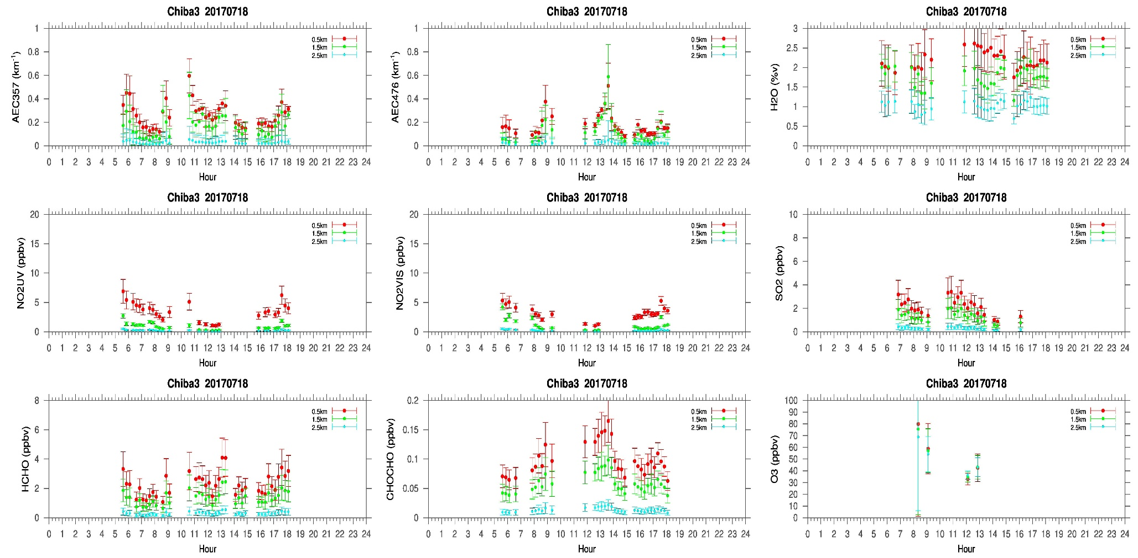
MAX-DOAS#3, East Direction

Slide 5
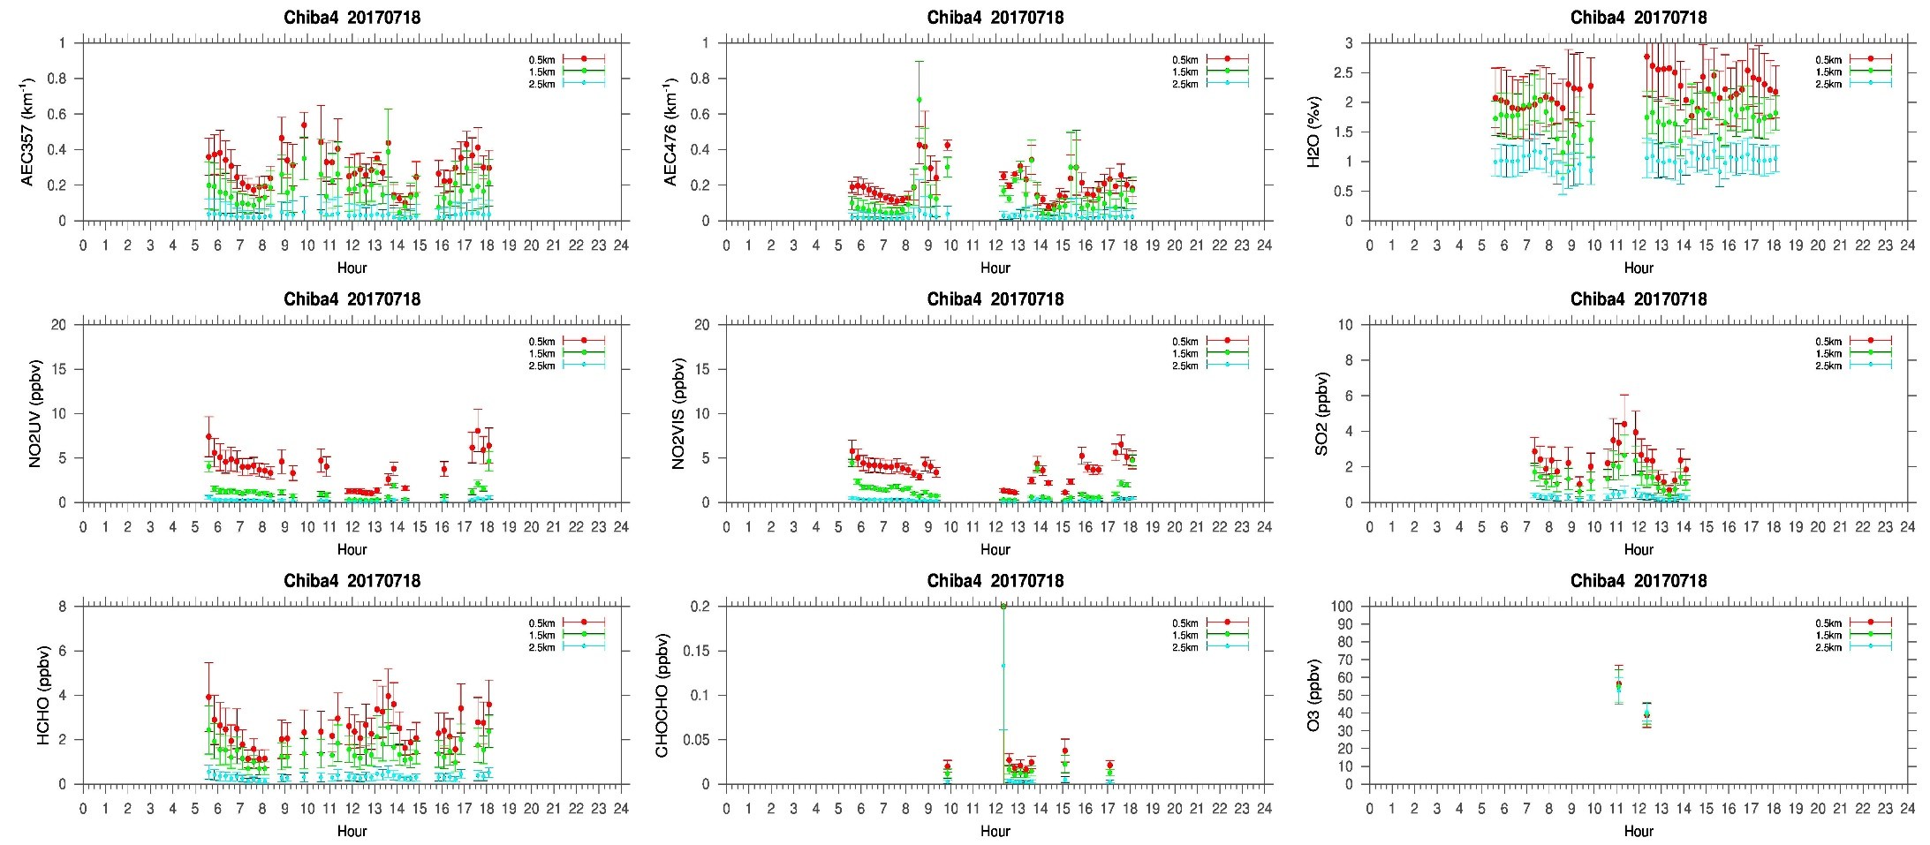
MAX-DOAS#4, South Direction

Slide 6
Comments after a quick look of the plots
A very cloudy day on the eight day of the campaign. Clouds were detected around 2 km. So, the AEC distribution is not as homogenous we have observed during the very clear days or when clouds were above 3 km. Despite the different cloudy condition during the campaign AEC for 0-1 km was between 0.4km⁻¹ – 0.2km⁻¹. NO₂ concentration (0-1km) was ~ 5ppbv and SO₂ concentration (0-1km) was ~ 2ppbv HCHO concentration (0-1km) varied between 2ppbv and 4ppbv, close to the background level (1-3 ppbv) concentration.

