Slide 1
MAX-DOAS 2d plots for Chiba Campaign 2017 Observation day 2: 07/12/2017 Hoque

Slide 2
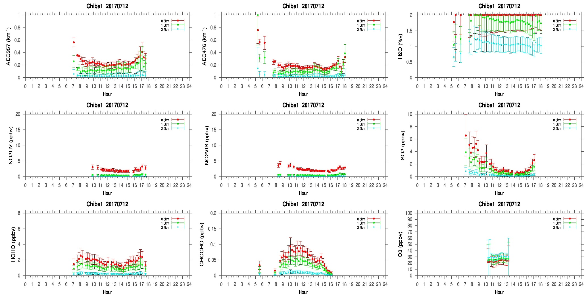
MAX-DOAS#1, North Direction

Slide 3
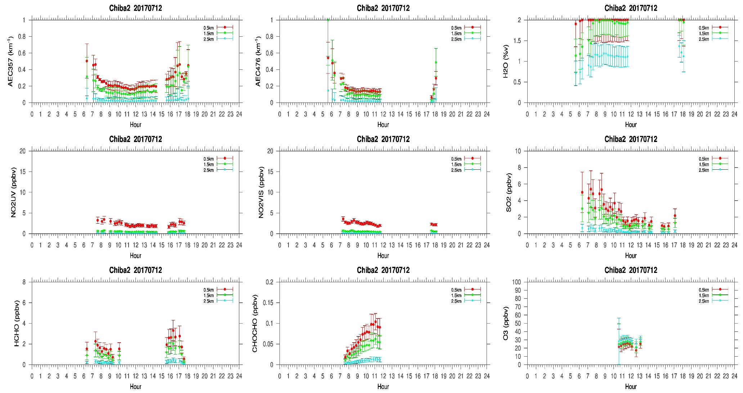
MAX-DOAS#2, West Direction

Slide 4
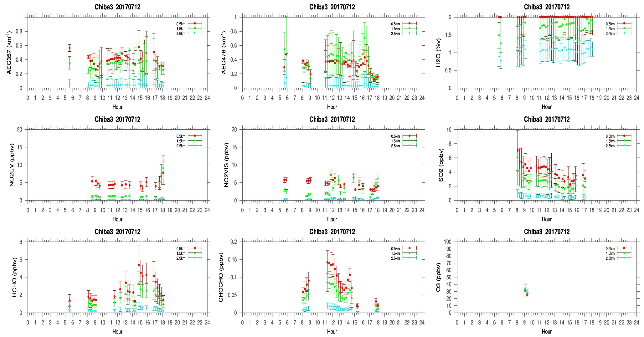
MAX-DOAS#3, East Direction

Slide 5
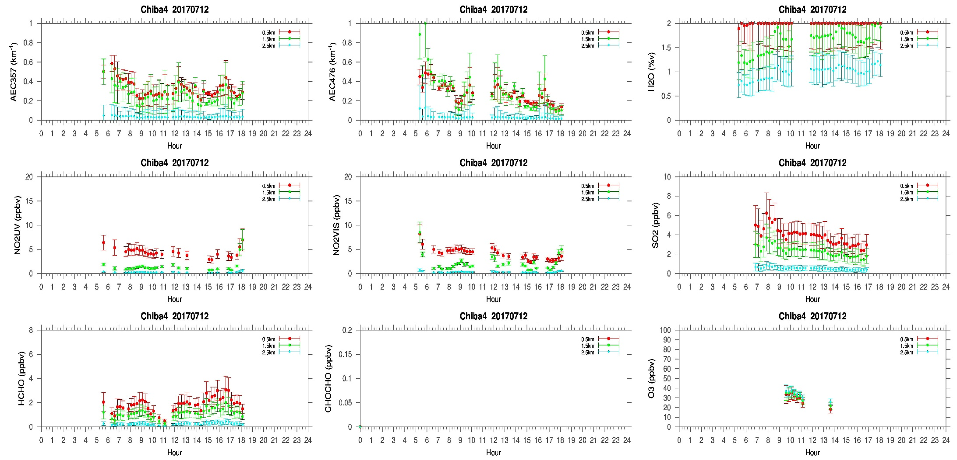
MAX-DOAS#4, South Direction

Slide 6
Comments after a quick look of the plots
07/12/2017 was a very clear day , according to the sky view and LIDAR images. The temporal variation of MAX-DOAS measurements in different directions were almost similar expect the instrument looking towards the east direction (MAX-DOAS#3). From a quick look of the sky view images, clouds were visible in the east direction from 10:00 JST. According to the LIDAR images, the cloud heights were between 1 to 2 km. This could be the reason for the discrepancy seen in the measurements from the MAX-DOAS pointing to the east. If such cloud influence is the reason for the difference observed in the temporal distribution, further data and cloud screening can possibly minimize the difference.

