Slide 1
Daily Report for Chiba Campaign (7/14 ∼ 7/23)
Al Mashroor Fatmi

Slide 2
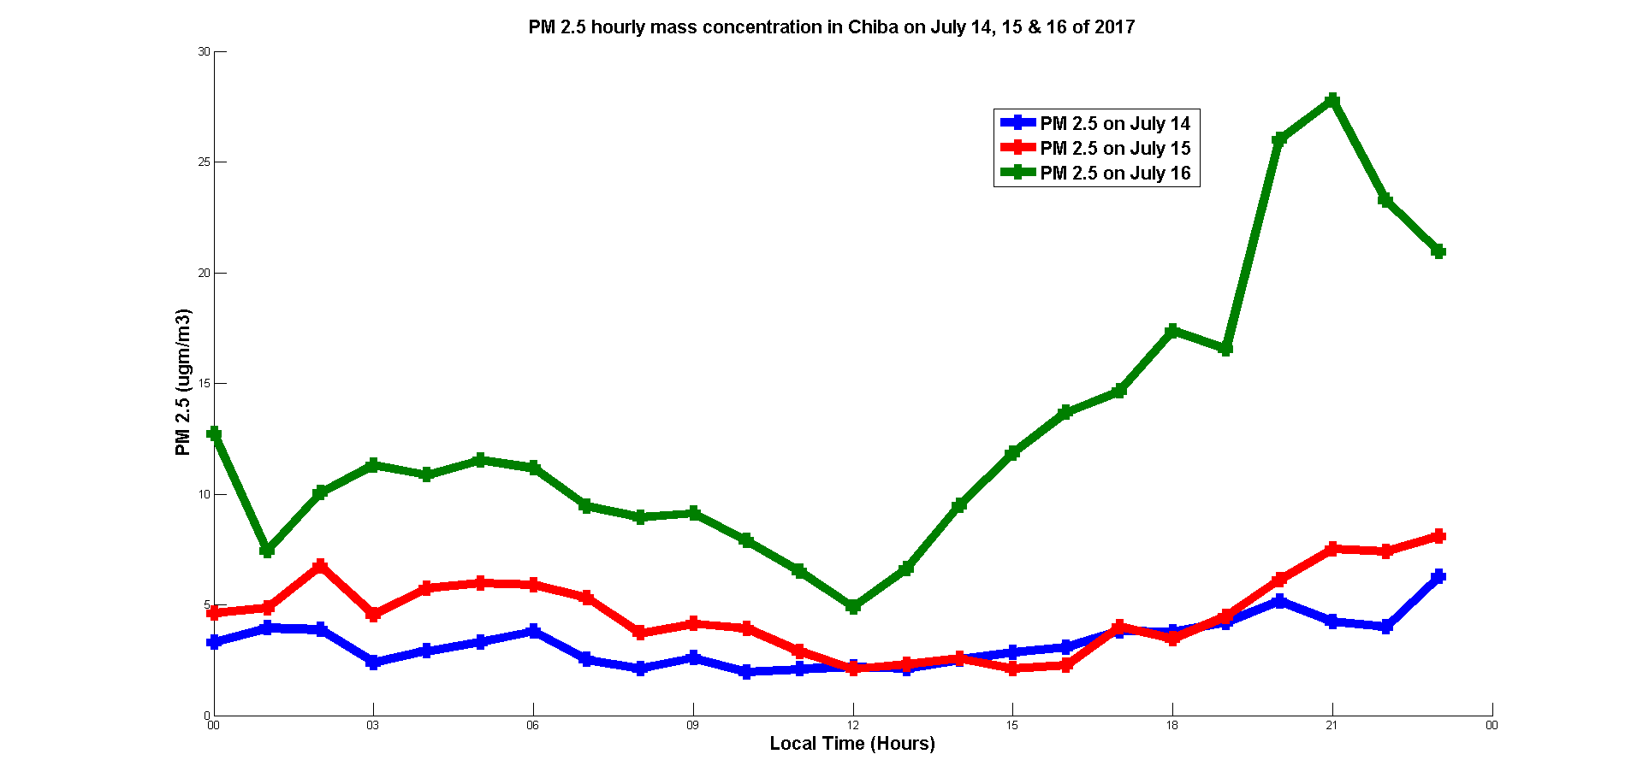
Hourly mean value of PM 2.5 measured on 7/14, 7/15 & 7/16

Slide 3
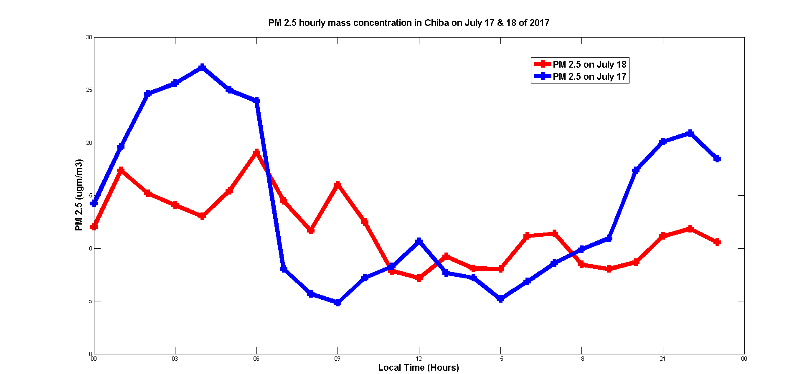
Hourly mean value of PM 2.5 measured on 7/17 & 7/18

Slide 4
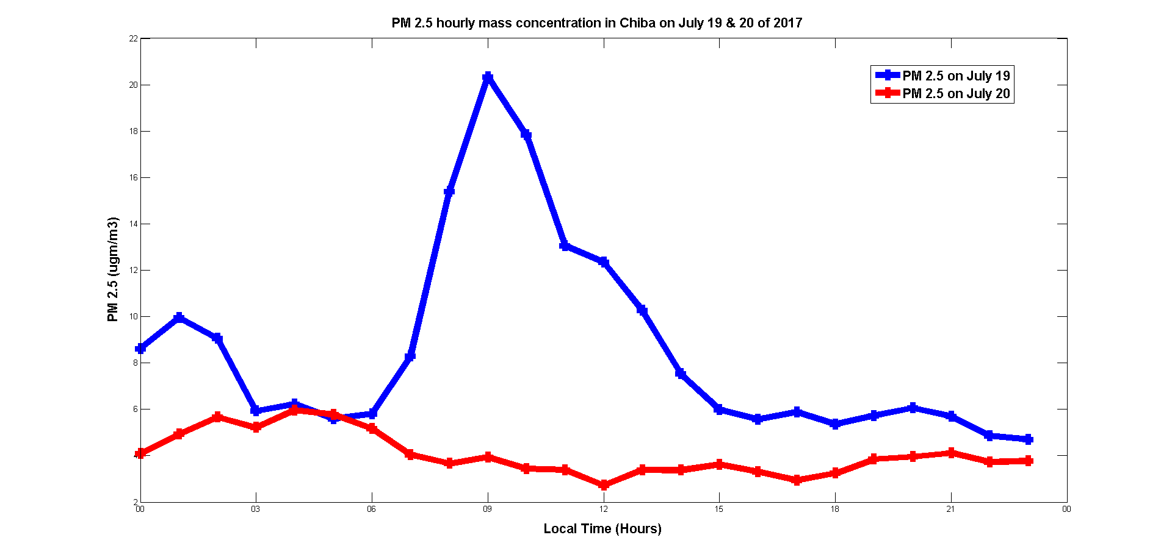
Hourly mean value of PM 2.5 measured on 7/19 & 7/20
A striking deviation of PM 2.5 value was noted at 9:00 A.M these two days. However, according to the PM 2.5 prediction by Yumimoto-san, a variation of PM 2.5 value was expected on July 20

Slide 5
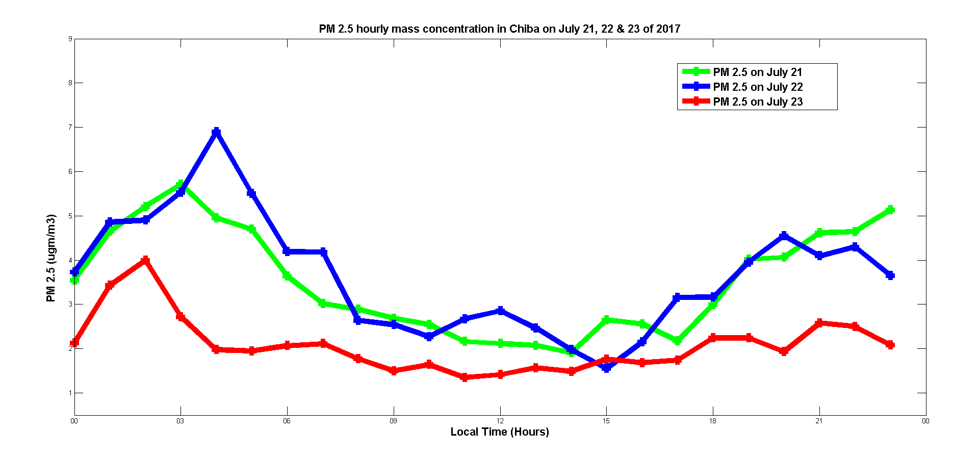
Hourly mean value of PM 2.5 measured on 7/21, 7/22 & 7/23

