Slide 1
Daily Report for Chiba Campaign (7/12)
Al Mashroor Fatmi

Slide 2
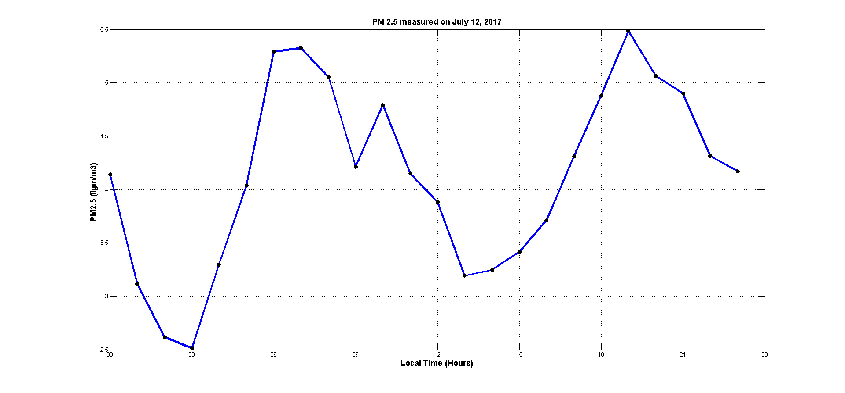
Hourly mean value of PM 2.5 measured on 7/12
Variation of value of PM 2.5 was observed comparing to the previous two days

Slide 3
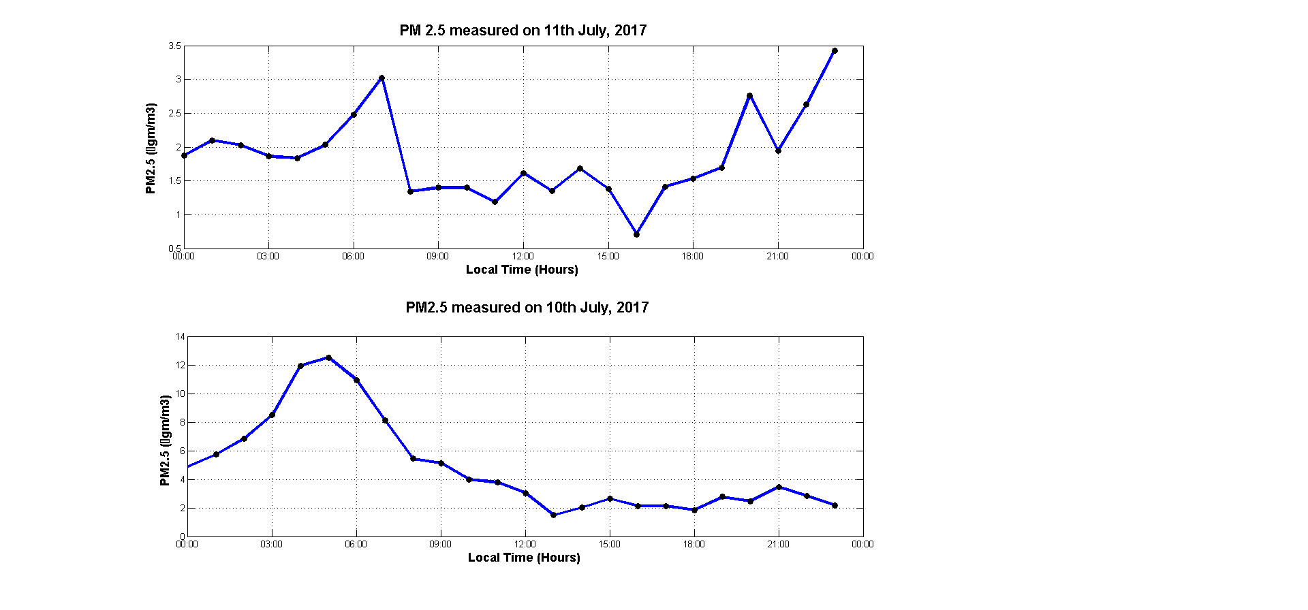
Hourly mean value of PM 2.5 measured on 7/11 & 7/10

