Slide 1
Daily Report for Chiba Campaign (7/11)
Al Mashroor Fatmi

Slide 2
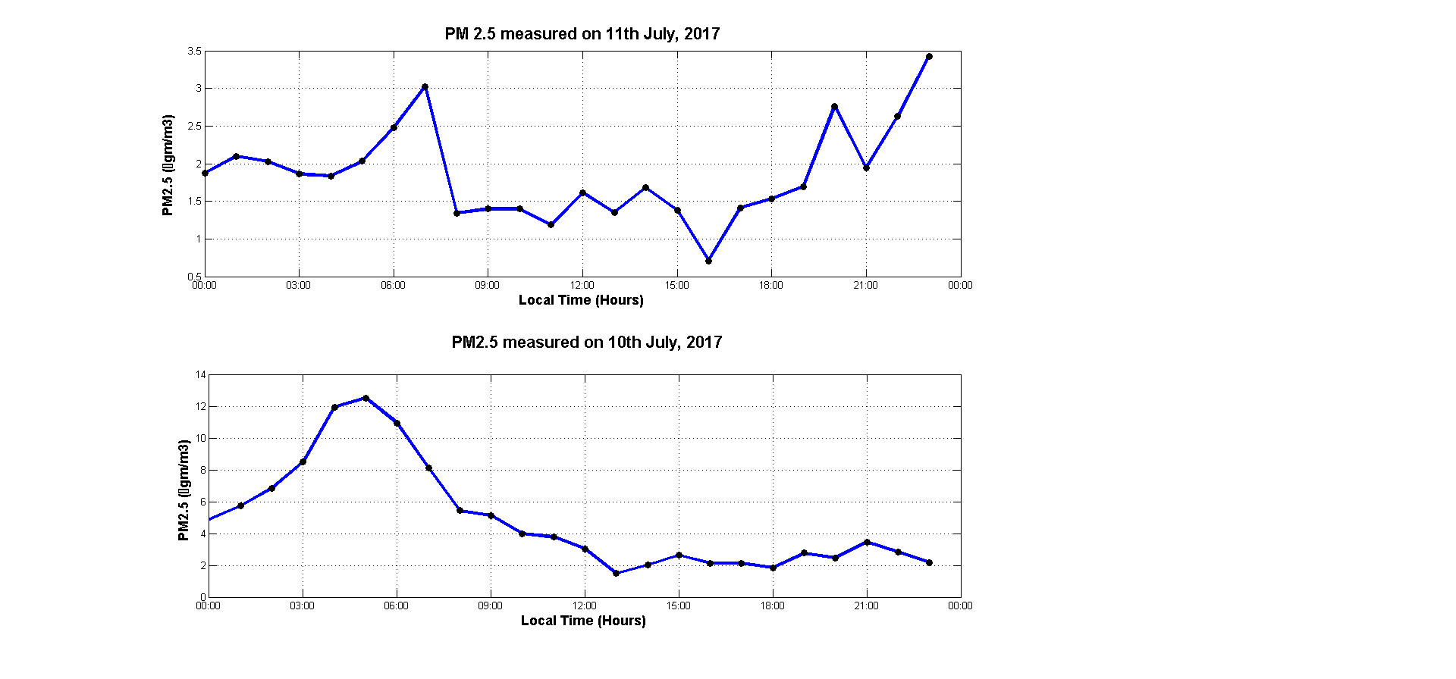
Comparison of PM 2.5 value measured on 7/10 & 7/11

